Slide 1
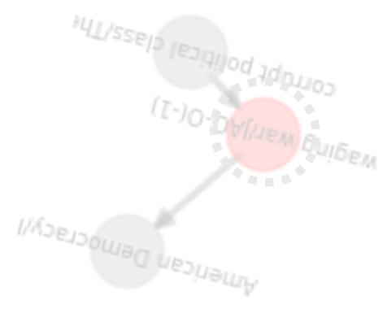


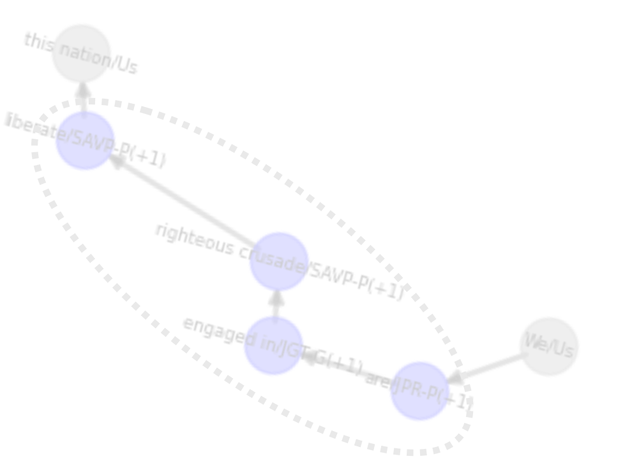
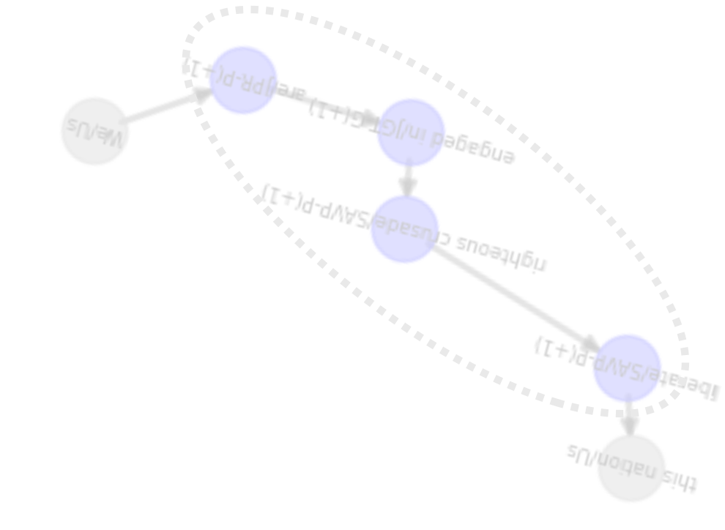




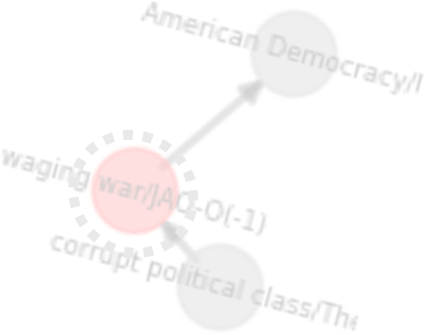
Using Network Motifs to Detect Populist Narratives at the Sub- sentence Level
Valentina Gonzalez-Rostani Bree Bang-Jensen Michael Colaresi
Princeton University
University of Georgia
University of Pittsburgh

Slide 2
Thin-Centered Populism: Measurement Challenges
Thin-centered: a flexible frame that can attach to various policies/contexts (Mudde, 2007).
Core “people vs. elite” conflict with moral stakes.
Different definitions of “the people” and “the elite” → blend w/ideological content.
Populist rhetoric often interlaces with non-populist ideas in the same speech
Existing measures are coarse:
Traditional approaches label entire speeches or actors as populist or not.
This glosses over internal variation.
Existing measures are coarse:
We need finer granularity to capture when and how populist narratives appear

Slide 3
Thin-Centered Populism: Measurement Challenges
Thin-centered: a flexible frame that can attach to various policies/contexts (Mudde, 2007).
Core “people vs. elite” conflict with moral stakes.
Different definitions of “the people” and “the elite” → blend w/ideological content.
Populist rhetoric often interlaces with non-populist ideas in the same speech
Existing measures are coarse:
Traditional approaches label entire speeches or actors as populist or not.
This glosses over internal variation.
Existing measures are coarse:
We need finer granularity to capture when and how populist narratives appear

Slide 4
Thin-Centered Populism: Measurement Challenges
Thin-centered: a flexible frame that can attach to various policies/contexts (Mudde, 2007).
Core “people vs. elite” conflict with moral stakes.
Different definitions of “the people” and “the elite” → blend w/ideological content.
Populist rhetoric often interlaces with non-populist ideas in the same speech
Existing measures are coarse:
Traditional approaches label entire speeches or actors as populist or not.
This glosses over internal variation.
Existing measures are coarse:
We need finer granularity to capture when and how populist narratives appear

Slide 5
Thin-Centered Populism: Measurement Challenges
Thin-centered: a flexible frame that can attach to various policies/contexts (Mudde, 2007).
Core “people vs. elite” conflict with moral stakes.
Different definitions of “the people” and “the elite” → blend w/ideological content.
Populist rhetoric often interlaces with non-populist ideas in the same speech
Existing measures are coarse:
Traditional approaches label entire speeches or actors as populist or not.
This glosses over internal variation.
Existing measures are coarse:
We need finer granularity to capture when and how populist narratives appear

Slide 6
Thin-Centered Populism: Measurement Challenges
Thin-centered: a flexible frame that can attach to various policies/contexts (Mudde, 2007).
Core “people vs. elite” conflict with moral stakes.
Different definitions of “the people” and “the elite” → blend w/ideological content.
Populist rhetoric often interlaces with non-populist ideas in the same speech
Existing measures are coarse:
Traditional approaches label entire speeches or actors as populist or not.
This glosses over internal variation.
Existing measures are coarse:
We need finer granularity to capture when and how populist narratives appear

Slide 7
Thin-Centered Populism: Measurement Challenges
Thin-centered: a flexible frame that can attach to various policies/contexts (Mudde, 2007).
Core “people vs. elite” conflict with moral stakes.
Different definitions of “the people” and “the elite” → blend w/ideological content.
Populist rhetoric often interlaces with non-populist ideas in the same speech
Existing measures are coarse:
Traditional approaches label entire speeches or actors as populist or not.
This glosses over internal variation.
Existing measures are coarse:
We need finer granularity to capture when and how populist narratives appear

Slide 8
The Aggregation Problem in Computational Measurement of
Populist
Speech
I will immediately restore and expand the Trump travel ban on an entry from terror plague countries, and I will implement strong ideological screening for all immigrants. If you hate America, if you want to abolish Israel, if you sympathize with Jihadists, then we don’t want you in our country. We don’t want you. Crooked Joe Biden puts China first, puts Asia first, puts Ukraine first, puts illegal aliens first, environmental maniacs first. Everyone else first. He puts everybody first. That’s bad. But he puts America last. He puts Nevada last. He puts our workers last. He frankly puts unions last. Look what he did with the car. They’re going to make all electric cars in our country, but not when I’m in there. I’ll end that the first day. He puts our families last.
…
In the new McLaughlin Poll of Nevada we’re at 75% while DeSanctimonious is at 60 points behind us. He’s at 15, so think of that, we’re at 75, just came out. We’re at 75. The DeSanctimonious is at 15, so we’re leading by 60 points. But here’s the thing you got to do, [inaudible 00:30:11], just go vote. Don’t think about it. Pretend we’re tied, pretend we’re losing by three. You got to do this because the worst thing is everyone thinks, “Oh, what do we have to vote for? Trump is killing them, and then bad things happen when that…” Pretend we’re losing. Assume that we’re down by three, four, or five, okay? You don’t want to do what the Washington Post does and others where they make it so that it doesn’t make sense. In Wisconsin for two elections, they put me down in Wisconsin at 17, I’m 17 down, right? I said, “No way I’m 17 down. No way.”
I asked John McLaughlin the great pollster, I said, “Why would they do that? I’m winning in Wisconsin.” He said, “They do that because that way people don’t vote.” I said, “What do you mean? Well, why don’t they do it like at 5:00? Because they do get killed when they lose.” He said, “They don’t care about that. At 17 people won’t vote. They’ll say, we love Trump, but we’re not going to vote for him. At 5:00 they say, he has a chance. We’ll vote.” I said, “Wow, that’s really sick, huh?” That’s what it is. That’s how bad they are that we won Wisconsin. They had us down 17 and we won Wisconsin, and then we did, frankly better the second time where we did better in most places the second time. People say, “How’d you do the second time?” I say, “We did much better.”
If you take a look, we got millions more votes a second time, and the new Rasmussen Poll of general election we’re dominating Biden by 10 points. That’s a lot because a friend of mine said, “How come you’re only winning by 10 or 14 points? There’s another one 14 points.” I said, “How could he be possibly that close?” But they have a lot of people voting for them that aren’t going to vote for us. But I’ll tell you, a lot of the people that would normally vote for them, like the union people are voting for us other than the top people in the unions and even some of the top people in the unions are going for us, this could be an incredible situation. African Americans, we have the highest poll numbers we’ve ever had. Hispanic Americans, we have the highest poll numbers the Republican Party has ever had.
We could actually win with Hispanics. I mean, it was unthinkable two or three years ago, we won the state of Florida. We did so well in Texas. We won the state of Texas and all of the border towns voted for Trump, and they’re about 85, 90% Hispanic and won every single town along the border. First time in… They say the first time since reconstruction. You know what reconstruction means? That means the Civil War. I said, “Give me a definition of reconstruction to the governor of Texas who endorsed me recently, by the way, as did almost everybody else.
…
Donald Trump, Reno, 12/2023

Slide 9
The Aggregation Problem in Computational Measurement of Populist Speech
I will immediately restore and expand the Trump travel ban on an entry from terror plague countries, and I will implement strong ideological screening for all immigrants. If you hate America, if you want to abolish Israel, if you sympathize with Jihadists, then we don’t want you in our country. We don’t want you. Crooked Joe Biden puts China first, puts Asia first, puts Ukraine first, puts illegal aliens first, environmental maniacs first. Everyone else first. He puts everybody first. That’s bad. But he puts America last. He puts Nevada last. He puts our workers last. He frankly puts unions last. Look what he did with the car. They’re going to make all electric cars in our country, but not when I’m in there. I’ll end that the first day. He puts our families last.
CODE WHOLE SPEECH/PARTY/PERSON AS POPULIST
..
In the new McLaughlin Poll of Nevada we’re at 75% while DeSanctimonious is at 60 points behind us. He’s at 15, so think of that, we’re at 75, just came out. We’re at 75. The DeSanctimonious is at 15, so we’re leading by 60 points. But here’s the thing you got to do, [inaudible 00:30:11], just go vote. Don’t think about it. Pretend we’re tied, pretend we’re losing by three. You got to do this because the worst thing is everyone thinks, “Oh, what do we have to vote for? Trump is killing them, and then bad things happen when that…” Pretend we’re losing. Assume that we’re down by three, four, or five, okay? You don’t want to do what the Washington Post does and others where they make it so that it doesn’t make sense. In Wisconsin for two elections, they put me down in Wisconsin at 17, I’m 17 down, right? I said, “No way I’m 17 down. No way.”
I asked John McLaughlin the great pollster, I said, “Why would they do that? I’m winning in Wisconsin.” He said, “They do that because that way people don’t vote.” I said, “What do you mean? Well, why don’t they do it like at 5:00? Because they do get killed when they lose.” He said, “They don’t care about that. At 17 people won’t vote. They’ll say, we love Trump, but we’re not going to vote for him. At 5:00 they say, he has a chance. We’ll vote.” I said, “Wow, that’s really sick, huh?” That’s what it is. That’s how bad they are that we won Wisconsin. They had us down 17 and we won Wisconsin, and then we did, frankly better the second time where we did better in most places the second time. People say, “How’d you do the second time?” I say, “We did much better.”
If you take a look, we got millions more votes a second time, and the new Rasmussen Poll of general election we’re dominating Biden by 10 points. That’s a lot because a friend of mine said, “How come you’re only winning by 10 or 14 points? There’s another one 14 points.” I said, “How could he be possibly that close?” But they have a lot of people voting for them that aren’t going to vote for us. But I’ll tell you, a lot of the people that would normally vote for them, like the union people are voting for us other than the top people in the unions and even some of the top people in the unions are going for us, this could be an incredible situation. African Americans, we have the highest poll numbers we’ve ever had. Hispanic Americans, we have the highest poll numbers the Republican Party has ever had.
We could actually win with Hispanics. I mean, it was unthinkable two or three years ago, we won the state of Florida. We did so well in Texas. We won the state of Texas and all of the border towns voted for Trump, and they’re about 85, 90% Hispanic and won every single town along the border. First time in… They say the first time since reconstruction. You know what reconstruction means? That means the Civil War. I said, “Give me a definition of reconstruction to the governor of Texas who endorsed me recently, by the way, as did almost everybody else.
…
Donald Trump, Reno, 12/2023

Slide 10
The Aggregation Problem
Within-speech variation:
Who are the people? Who are the elites? What is the grievance?
Populism + other themes: An entire speech labeled ‘populist’ often contains nationalism or protectionism…
→ Aggregating to one label conflates populist content with these themes.
Can’t quantify or locate populism
how much of the speech was populist or which parts?
Loss of interpretability

Slide 11
The Aggregation Problem
Within-speech variation:
Who are the people? Who are the elites? What is the grievance?
Populism + other themes: An entire speech labeled ‘populist’ often contains nationalism or protectionism…
→ Aggregating to one label conflates populist content with these themes.
Can’t quantify or locate populism
how much of the speech was populist or which parts?
Loss of interpretability

Slide 12
The Aggregation Problem
Within-speech variation:
Who are the people? Who are the elites? What is the grievance?
Populism + other themes: An entire speech labeled ‘populist’ often contains nationalism or protectionism…
→ Aggregating to one label conflates populist content with these themes.
Can’t quantify or locate populism
how much of the speech was populist or which parts?
Loss of interpretability

Slide 13
The Aggregation Problem
Within-speech variation:
Who are the people? Who are the elites? What is the grievance?
Populism + other themes: An entire speech labeled ‘populist’ often contains nationalism or protectionism…
→ Aggregating to one label conflates populist content with these themes.
Can’t quantify or locate populism
how much of the speech was populist or which parts?
Loss of interpretability

Slide 14
The Aggregation Problem
Within-speech variation:
Who are the people? Who are the elites? What is the grievance?
Populism + other themes: An entire speech labeled ‘populist’ often contains nationalism or protectionism…
→ Aggregating to one label conflates populist content with these themes.
Can’t quantify or locate populism
how much of the speech was populist or which parts?
Loss of interpretability

Slide 15
Our Contribution
Interpretable: Provide a theoretically and empirically powerful tool for populism research
Scalable: Demonstrate value of incorporating LLMs into our analytical pipeline:
→ to generate reliable token-level annotations & synthetic data
Evaluation tool: Provide Graph Edit Distance as an evaluation/analysis tool
Develop a scalable, interpretable method that identifies populist narrative structures at the most meaningful level of analysis – the actual sentences

Slide 16
Our Contribution
Interpretable: Provide a theoretically and empirically powerful tool for populism research
Scalable: Demonstrate value of incorporating LLMs into our analytical pipeline:
→ to generate reliable token-level annotations & synthetic data
Evaluation tool: Provide Graph Edit Distance as an evaluation/analysis tool
Develop a scalable, interpretable method that identifies populist narrative structures at the most meaningful level of analysis – the actual sentences

Slide 17
Our Contribution
Interpretable: Provide a theoretically and empirically powerful tool for populism research
Scalable: Demonstrate value of incorporating LLMs into our analytical pipeline:
→ to generate reliable token-level annotations & synthetic data
Evaluation tool: Provide Graph Edit Distance as an evaluation/analysis tool
Develop a scalable, interpretable method that identifies populist narrative structures at the most meaningful level of analysis – the actual sentences

Slide 18
Our Contribution
Interpretable: Provide a theoretically and empirically powerful tool for populism research
Scalable: Demonstrate value of incorporating LLMs into our analytical pipeline:
→ to generate reliable token-level annotations & synthetic data
Evaluation tool: Provide Graph Edit Distance as an evaluation/analysis tool
Develop a scalable, interpretable method that identifies populist narrative structures at the most meaningful level of analysis – the actual sentences

Slide 19
Our Approach:
Fine-grained Interpretable Measure of Populism
Valentina Gonzalez-Rostani, Bree Bang-Jensen, and Michael Colaresi

Slide 20

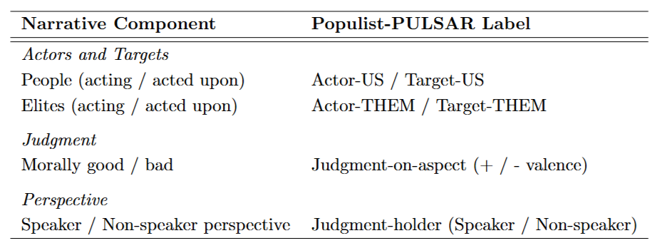
Measuring Thin-centered Populism in Text
Populist narratives have defining traits:
Narrative Component | Populist-PULSAR Label
Actors and Targets
People (acting / acted upon) | Actor-US / Target-US
Elites (acting / acted upon) | Actor-THEM / Target-THEM
Judgment
Morally good / bad | Judgment-on-aspect (+ / - valence)
Perspective
Speaker / Non-speaker perspective | Judgment-holder (Speaker / Non-speaker)
Them
Them

Slide 21
Measuring Thin-centered Populism in Text
Populist narratives have defining traits:
Narrative Component | Populist-PULSAR Label
Actors and Targets
People (acting / acted upon) | Actor-US / Target-US
Elites (acting / acted upon) | Actor-THEM / Target-THEM
Judgment
Morally good / bad | Judgment-on-aspect (+ / - valence)
Perspective
Speaker / Non-speaker perspective | Judgment-holder (Speaker / Non-speaker)
Them
Them

Slide 22
Measuring Thin-centered Populism in Text
Populist narratives have defining traits:
Narrative Component | Populist-PULSAR Label
Actors and Targets
People (acting / acted upon) | Actor-US / Target-US
Elites (acting / acted upon) | Actor-THEM / Target-THEM
Judgment
Morally good / bad | Judgment-on-aspect (+ / - valence)
Perspective
Speaker / Non-speaker perspective | Judgment-holder (Speaker / Non-speaker)
Them
Them

Slide 23

The Structure of Populism
We cast theoretical populist narrative structures:
Recurring graphs that represent the core “people vs elite”.
Each motif links an Actor to a Target through a valence action (judgment on an aspect).
Four representative populist motifs
Us
Them
Us
Them
Us
Us
Them
Us
Them
Them

Slide 24
The Structure of Populism
We cast theoretical populist narrative structures:
Core “people vs elite”.
Each structure links an Actor to a Target through a valence action (judgment on an aspect).
Four representative populist motifs
Us
Them
Us
Them
Us
Us
Them
Us
Them
Them

Slide 25
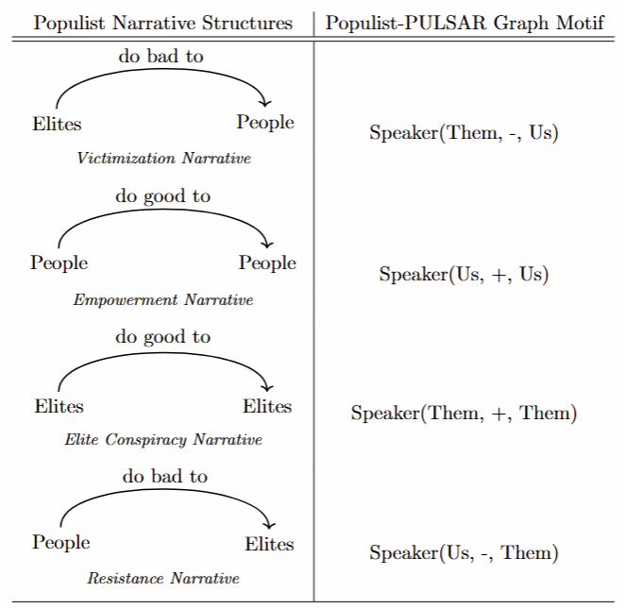
The Structure of Populism
We cast theoretical populist narrative structures:
Core “people vs elite”.
Each structure links an Actor to a Target through a valence action (judgment on an aspect).
Four representative populist narrative structures
Us
Them
Us
Them
Us
Us
Them
Us
Them
Them

Slide 26
The Structure of Populism
We cast theoretical populist narrative structures:
Core “people vs elite”.
Each structure links an Actor to a Target through a valence action (judgment on an aspect).
Four representative populist narrative structures
Us
Them
Us
Them
Us
Us
Them
Us
Them
Them

Slide 27

Measuring Thin-centered Populism in Text
Populist narratives have defining traits:
Narrative Component | Populist-PULSAR Label
Actors and Targets
People (acting / acted upon) | Actor-US / Target-US
Elites (acting / acted upon) | Actor-THEM / Target-THEM
Judgment
Morally good / bad | Judgment-on-aspect (+ / - valence)
Perspective
Speaker / Non-speaker perspective | Judgment-holder (Speaker / Non-speaker)
Us
Them
Us
Us
Us
Us
Them
Them
Them

Slide 28
The Structure of Populism as Graph Motif
We measure populist narrative structures:
Labels (nodes)
Actor vs Target (direction)
Valence (edges)
Perspective (graph attribute)
Four representative populist motifs
Us
Them
Us
Them
Us
Us
Them
Us
Them
Them

Slide 29
The Structure of Populism as Graph Motif
We measure populist narrative structures:
Labels (nodes)
Actor vs Target (edge direction)
Valence (edges)
Perspective (graph attribute)
Four representative populist motifs
Us
Them
Us
Them
Us
Us
Them
Us
Them
Them

Slide 30
Populist-PULSAR Structure

Slide 31
Populist-PULSAR Structure
Victimization
“A small group in our nation’s Capital has reaped the rewards of government while the people have borne the cost.”
Empowerment
“We will bring back our jobs.”
Elite Conspiracy
“Insiders fighting for insiders.”
Resistance
“We are transferring power from Washington, D.C”

Slide 32
Populist-PULSAR Structure
Victimization
“A small group in our nation’s Capital has reaped the rewards of government while the people have borne the cost.”
Them
Us

Slide 33
Populist-PULSAR Structure
Victimization
“A small group in our nation’s Capital has reaped the rewards of government while the people have borne the cost.”
Empowerment
“We will bring back our jobs.”
Them
Us

Slide 34
Populist-PULSAR Structure
Victimization
“A small group in our nation’s Capital has reaped the rewards of government while the people have borne the cost.”
Empowerment
“We will bring back our jobs.”
Them
Us
Them
Us
Us

Slide 35
Populist-PULSAR Structure
Victimization
“A small group in our nation’s Capital has reaped the rewards of government while the people have borne the cost.”
Empowerment
“We will bring back our jobs.”
Elite Conspiracy
“Insiders fighting for insiders.”
Resistance
“We are transferring power from Washington, D.C”
Them
Us
Them
Us
Us

Slide 36
Populist-PULSAR Structure
Victimization
“A small group in our nation’s Capital has reaped the rewards of government while the people have borne the cost.”
Empowerment
“We will bring back our jobs.”
Elite Conspiracy
“Insiders fighting for insiders.”
Them
Us
Them
Us
Us
Them
Them
Them

Slide 37
Populist-PULSAR Structure
Victimization
“A small group in our nation’s Capital has reaped the rewards of government while the people have borne the cost.”
Empowerment
“We will bring back our jobs.”
Elite Conspiracy
“Insiders fighting for insiders.”
Resistance
“We are transferring power from Washington, D.C”
Them
Us
Them
Us
Us
Them
Them
Them

Slide 38
Populist-PULSAR Structure
Victimization
“A small group in our nation’s Capital has reaped the rewards of government while the people have borne the cost.”
Empowerment
“We will bring back our jobs.”
Elite Conspiracy
“Insiders fighting for insiders.”
Resistance
“We are transferring power from Washington, D.C”
Them
Us
Them
Us
Us
Them
Them
Them
Us
Them

Slide 39
Identifying Populist Narratives: Structure Matters

Slide 40
Identifying Populist Narratives: Structure Matters
A sentence can include populist components but still not form a populist narrative if the structure isn't correct.
Example of a non-populist narrative:
(Contains populist elements but arranged incorrectly.)

Slide 41
Identifying Populist Narratives: Structure Matters
A sentence can include populist components but still not form a populist narrative if the structure isn't correct.
Example of a non-populist narrative:
(Contains populist elements but arranged incorrectly.)
Elites Help People

Slide 42
Identifying Populist Narratives: Structure Matters
A sentence can include populist components but still not form a populist narrative if the structure isn't correct.
Example of a non-populist narrative:
(Contains populist elements but arranged incorrectly.)
Elites Help People
Them
Them
Us
Us

Slide 43
Identifying Populist Narratives: Structure Matters
A sentence can include populist components but still not form a populist narrative if the structure isn't correct.
Example of a non-populist narrative:
(Contains populist elements but arranged incorrectly.)
Elites Help People
Them
Us
Them
Us
Us

Slide 44
Identifying Populist Narratives: Structure Matters
A sentence can include populist components but still not form a populist narrative if the structure isn't correct.
Example of a non-populist narrative:
(Contains populist elements but arranged incorrectly.)
Elites Help People
Them
Us
Them
Us
Us

Slide 45
Identifying Populist Narratives: Structure Matters
A sentence can include populist components but still not form a populist narrative if the structure isn't correct.
Example of a non-populist narrative:
(Contains populist elements but arranged incorrectly.)
Elites Help People
Them
Us
Them
Us
Us

Slide 46
The Aggregation Problem in Computational Measurement of Populist Speech
I will immediately restore and expand the Trump travel ban on an entry from terror plague countries, and I will implement strong ideological screening for all immigrants. If you hate America, if you want to abolish Israel, if you sympathize with Jihadists, then we don’t want you in our country. We don’t want you. Crooked Joe Biden puts China first, puts Asia first, puts Ukraine first, puts illegal aliens first, environmental maniacs first. Everyone else first. He puts everybody first. That’s bad. But he puts America last. He puts Nevada last. He puts our workers last. He frankly puts unions last. Look what he did with the car. They’re going to make all electric cars in our country, but not when I’m in there. I’ll end that the first day. He puts our families last.
..
In the new McLaughlin Poll of Nevada we’re at 75% while DeSanctimonious is at 60 points behind us. He’s at 15, so think of that, we’re at 75, just came out. We’re at 75. The DeSanctimonious is at 15, so we’re leading by 60 points. But here’s the thing you got to do, [inaudible 00:30:11], just go vote. Don’t think about it. Pretend we’re tied, pretend we’re losing by three. You got to do this because the worst thing is everyone thinks, “Oh, what do we have to vote for? Trump is killing them, and then bad things happen when that…” Pretend we’re losing. Assume that we’re down by three, four, or five, okay? You don’t want to do what the Washington Post does and others where they make it so that it doesn’t make sense. In Wisconsin for two elections, they put me down in Wisconsin at 17, I’m 17 down, right? I said, “No way I’m 17 down. No way.”
I asked John McLaughlin the great pollster, I said, “Why would they do that? I’m winning in Wisconsin.” He said, “They do that because that way people don’t vote.” I said, “What do you mean? Well, why don’t they do it like at 5:00? Because they do get killed when they lose.” He said, “They don’t care about that. At 17 people won’t vote. They’ll say, we love Trump, but we’re not going to vote for him. At 5:00 they say, he has a chance. We’ll vote.” I said, “Wow, that’s really sick, huh?” That’s what it is. That’s how bad they are that we won Wisconsin. They had us down 17 and we won Wisconsin, and then we did, frankly better the second time where we did better in most places the second time. People say, “How’d you do the second time?” I say, “We did much better.”
If you take a look, we got millions more votes a second time, and the new Rasmussen Poll of general election we’re dominating Biden by 10 points. That’s a lot because a friend of mine said, “How come you’re only winning by 10 or 14 points? There’s another one 14 points.” I said, “How could he be possibly that close?” But they have a lot of people voting for them that aren’t going to vote for us. But I’ll tell you, a lot of the people that would normally vote for them, like the union people are voting for us other than the top people in the unions and even some of the top people in the unions are going for us, this could be an incredible situation. African Americans, we have the highest poll numbers we’ve ever had. Hispanic Americans, we have the highest poll numbers the Republican Party has ever had.
…
We can handle that if we have the right president, but
what’s very difficult are these corrupt communists that we have within our own country. They’re very dangerous people, and
you must never forget, this nation does not belong to them. This nation belongs to you, it belongs to you. This is your home. This is your heritage, and our American liberty is your
God-given right.
…
Donald Trump, Reno, 12/2023

Slide 47
The Aggregation Problem in Computational Measurement of Populist Speech
I will immediately re_{U}sto_{s}re and expand_{T}t_{h}h_{e}e_{m}Trump travel ban on an entry from terror plague countries, and I will implement strong ideological screening for all immigrants. If you hate America, if you want to abolish Israel, if you sympathize with Jihadists, then we don’t want you in our country. We_{T}d_{h}on_{e}’_{m}t want you. Crooked Joe Biden puts China first, puts Asia first, puts Ukraine first, puts illegal aliens first, environmental maniacs first. Everyone else first. He puts everybody first. That’s bad. But Thehepumts America last. He puts Nevada last. He puts our workers last. He frankly puts unions last. Look whaTthheemdid with the car. ThUeys’re going to make all electric cars in our country, but not when I’m in there. I’ll end
that the first day. He puts our families last.
..
In the new McLaughlin Poll of Nevada we’re at 75% while DeSanctimonious is at 60 points behind us. He’s at 15, so think of that, we’re at 75, just came out. We’re at 75. The DeSanctimonious is at 15, so we’re leading by 60 points. But here’s the thing you got to do, [inaudible 00:30:11], just go vote. Don’t think about it. Pretend we’re tied, pretend we’re losing by three. You got to do this because the worst thing is everyone thinks, “Oh, what do we have to vote for? Trump is killing them, and then bad things happen when that…” Pretend we’re losing. Assume that we’re down by three, four, or five, okay? You don’t want to do what the Washington Post does and others where they make it so that it doesn’t make sense. In Wisconsin for two elections, they put me down in Wisconsin at 17, I’m 17 down, right? I said, “No way I’m 17 down. No way.”
I asked John McLaughlin the great pollster, I said, “Why would they do that? I’m winning in Wisconsin.” He said, “They do that because that way people don’t vote.” I said, “What do you mean? Well, why don’t they do it like at 5:00? Because they do get killed when they lose.” He said, “They don’t care about that. At 17 people won’t vote. They’ll say, we love Trump, but we’re not going to vote for him. At 5:00 they say, he has a chance. We’ll vote.” I said, “Wow, that’s really sick, huh?” That’s what it is. That’s how bad they are that we won Wisconsin. They had us down 17 and we won Wisconsin, and then we did, frankly better the second time where we did better in most places the second time. People say, “How’d you do the second time?” I say, “We did much better.”
If you take a look, we got millions more votes a second time, and the new Rasmussen Poll of general election we’re dominating Biden by 10 points. That’s a lot because a friend of mine said, “How come you’re only winning by 10 or 14 points? There’s another one 14 points.” I said, “How could he be possibly that close?” But they have a lot of people voting for them that aren’t going to vote for us. But I’ll tell you, a lot of the people that would normally vote for them, like the union people are voting for us other than the top people in the unions and even some of the top people in the unions are going for us, this could be an incredible situation. African Americans, we have the highest poll numbers we’ve ever had. Hispanic Americans, we have the highest poll numbers the Republican Party has ever had.
…
We can handle that if we have the right president, but wha_{T}t’_{h}s _{e}ve_{m}ry difficult are thes_{U}e_{s}corrupt communists that we have within our own country. They’re very dangerous people, and you must never forget, this nation does not belong to them. This nation belongs to you, it belongs to you. This is your hUomse. This is your hUersitage, and our American liberty is your
God-given right.
…
Donald Trump, Reno, 12/2023

Slide 48
Graph Edit Distance
Valentina Gonzalez-Rostani, Bree Bang-Jensen, and Michael Colaresi

Slide 49
Matching Extracted Structures to Populist Motifs via GED
Purpose: Quantify closeness of extracted graphs to populist motifs
Method: Custom Graph Edit Distance (GED) measure
Advantages:
Captures substantive alignment beyond superficial wording
Flexibility: Allows partial matches and exact matching as special cases
Evaluation: Compares automated extraction to human annotations
Distance Calculation: Penalizes significant shifts in actors, targets, or valence

Slide 50
Matching Extracted Structures to Populist Motifs via GED
Purpose: Quantify closeness of extracted graphs to populist motifs
Method: Custom GED measure
Advantages:
Captures substantive alignment beyond superficial wording
Flexibility: Allows partial matches and exact matching as special cases
Evaluation: Compares automated extraction to human annotations
Distance Calculation: Penalizes significant shifts in actors, targets, or valence

Slide 51
Matching Extracted Structures to Populist Motifs via GED
Purpose: Quantify closeness of extracted graphs to populist motifs
Method: Custom GED measure
Advantages:
Captures substantive alignment beyond superficial wording
Flexibility: Allows partial matches and exact matching as special cases
Evaluation: Compares automated extraction to human annotations
Distance Calculation: Penalizes significant shifts in actors, targets, or valence

Slide 52
Matching Extracted Structures to Populist Motifs via GED
Purpose: Quantify closeness of extracted graphs to populist motifs
Method: Custom GED measure
Advantages:
Captures substantive alignment beyond superficial wording
Flexibility: Allows partial matches and exact matching as special cases
Evaluation: Compares automated extraction to human annotations
Distance Calculation: Penalizes significant shifts in actors, targets, or valence

Slide 53
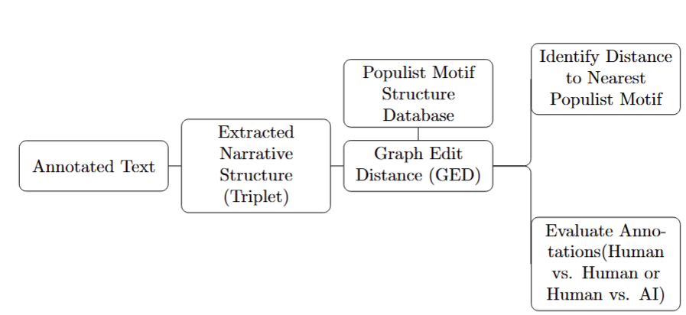
Matching Extracted Structures to Populist Motifs via GED

Slide 54
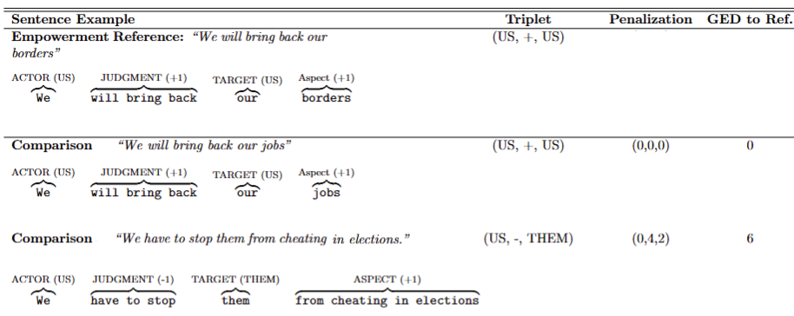
Matching Extracted Structures to Populist Motifs via GED

Slide 55
Matching Extracted Structures to Populist Motifs via GED

Slide 56
Matching Extracted Structures to Populist Motifs via GED

Slide 57
Matching Extracted Structures to Populist Motifs via GED

Slide 58
Matching Extracted Structures to Populist Motifs via GED

Slide 59
Our Approach:
Making Populist-PULSAR Accessible at Scale
Valentina Gonzalez-Rostani, Bree Bang-Jensen, and Michael Colaresi

Slide 60
Making Populist-PULSAR Accessible at Scale
Challenge: Manual annotation costly at large scale
Solution: Integration of human annotations & computational tools (NLP, ML, LLMs)
Annotation Expansion:
Prompt-based annotations via LLMs
Synthetic data generation
Data Scope: U.S. political speeches (2008-present)
Result: Detailed annotations identifying narrative motifs with textual precision

Slide 61
Making Populist-PULSAR Accessible at Scale
Challenge: Manual annotation costly at large scale
Solution: Integration of human annotations & computational tools (NLP, ML, LLMs)
Annotation Expansion:
Prompt-based annotations via LLMs
Synthetic data generation
Data Scope: U.S. political speeches (2008-present)
Result: Detailed annotations identifying narrative motifs with textual precision

Slide 62
Making Populist-PULSAR Accessible at Scale
Challenge: Manual annotation costly at large scale
Solution: Integration of human annotations & computational tools (NLP, ML, LLMs)
Annotation Expansion:
Prompt-based annotations via LLMs
Synthetic data generation
Data Scope: U.S. political speeches (2008-present)
Result: Detailed annotations identifying narrative motifs with textual precision

Slide 63
Making Populist-PULSAR Accessible at Scale
Challenge: Manual annotation costly at large scale
Solution: Integration of human annotations & computational tools (NLP, ML, LLMs)
Annotation Expansion:
Prompt-based annotations via LLMs
Synthetic data generation
Data Scope: U.S. political speeches (2008-present)
Result: Detailed annotations identifying narrative motifs with textual precision

Slide 64
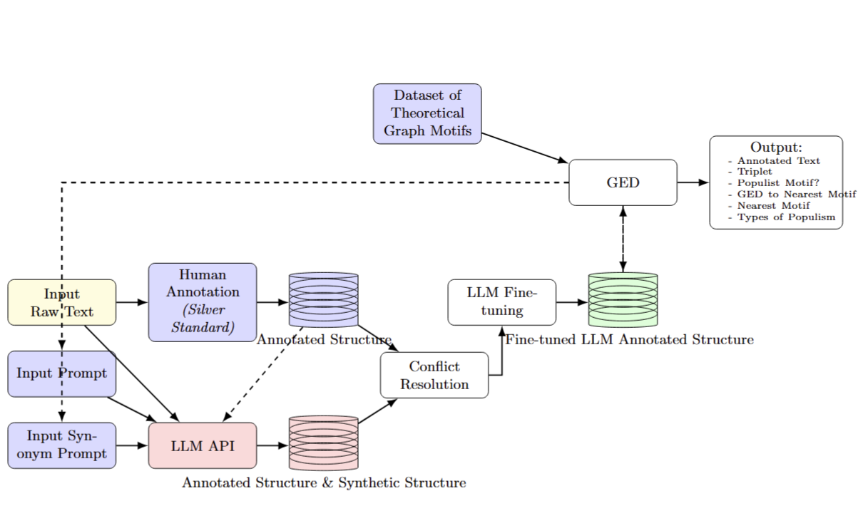
The Computational Steps from Unannotated Texts to Extracting Narrative Structure

Slide 65
The Computational Steps from Unannotated Texts to Extracting Narrative Structure

Slide 66
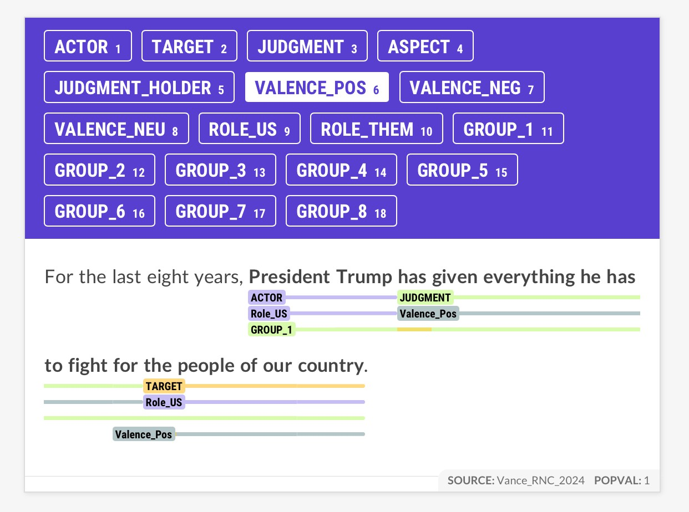
Hand-annotate using Prodigy system

Slide 67
Hand-annotate using Prodigy system
Input to few-shot LLM to label
jsonl format

Slide 68
Hand-annotate using Prodigy system
Input to few-shot LLM to label
jsonl format
Human readable
Us Us
(President Trump, +1, people of our country)

Slide 69
The Computational Steps from Unannotated Texts to Extracting Narrative Structure

Slide 70
The Computational Steps from Unannotated Texts to Extracting Narrative Structure
OpenAI API
gpt-4o-mini-2024-07-18

Slide 71
The Computational Steps from Unannotated Texts to Extracting Narrative Structure

Slide 72
Fine-tunning Our Models - PyTorch
Sentence-Level Approach | Token-Level Approach

Slide 73
Fine-tunning Our Models - PyTorch
Sentence-Level Approach | Token-Level Approach
DistilBERT multi-task fine-tuning | Separate BERT models for BIO tagging
Binary classification for each label | Identifies precise token spans
Joint optimization | Fine-tuned individually per component

Slide 74
Fine-tunning Our Models - PyTorch
Sentence-Level Approach
DistilBERT multi-task fine-tuning
Binary classification for each label
Joint optimization
Label | Attribute | Precision | Recall | F1
Actor | Them | 0.86 | 0.86 | 0.86
 | Residual | 0.91 | 0.91 | 0.91
 | Us | 0.93 | 0.93 | 0.93
Target | Them | 1.00 | 0.90 | 0.95
 | Residual | 1.00 | 0.83 | 0.91
 | Us | 0.88 | 1.00 | 0.93
Judgment | -1 | 0.93 | 0.87 | 0.90
 | +1 | 0.89 | 0.96 | 0.93
Aspect | -1 | 0.86 | 0.55 | 0.67
 | +1 | 0.59 | 0.89 | 0.71

Slide 75
Fine-tunning Our Models - PyTorch
Token-Level Approach
Separate BERT models for BIO tagging
Identifies precise token spans
Fine-tuned individually per component
We continue to improve the system and add more training data!

Slide 76
The Computational Steps from Unannotated Texts to Extracting Narrative Structure

Slide 77
Populist Narrative Structure
Cast THEORETICAL populist narrative types as network motifs

Slide 78
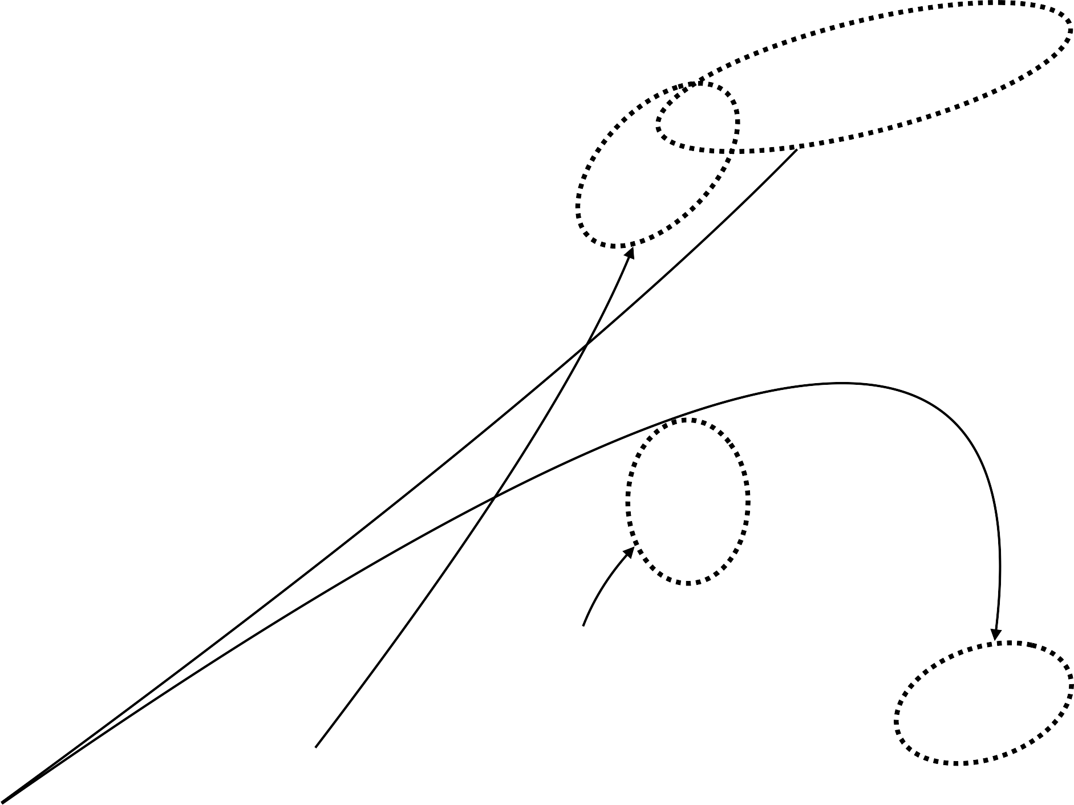
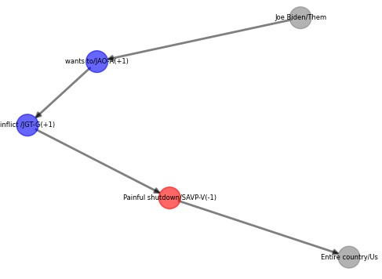
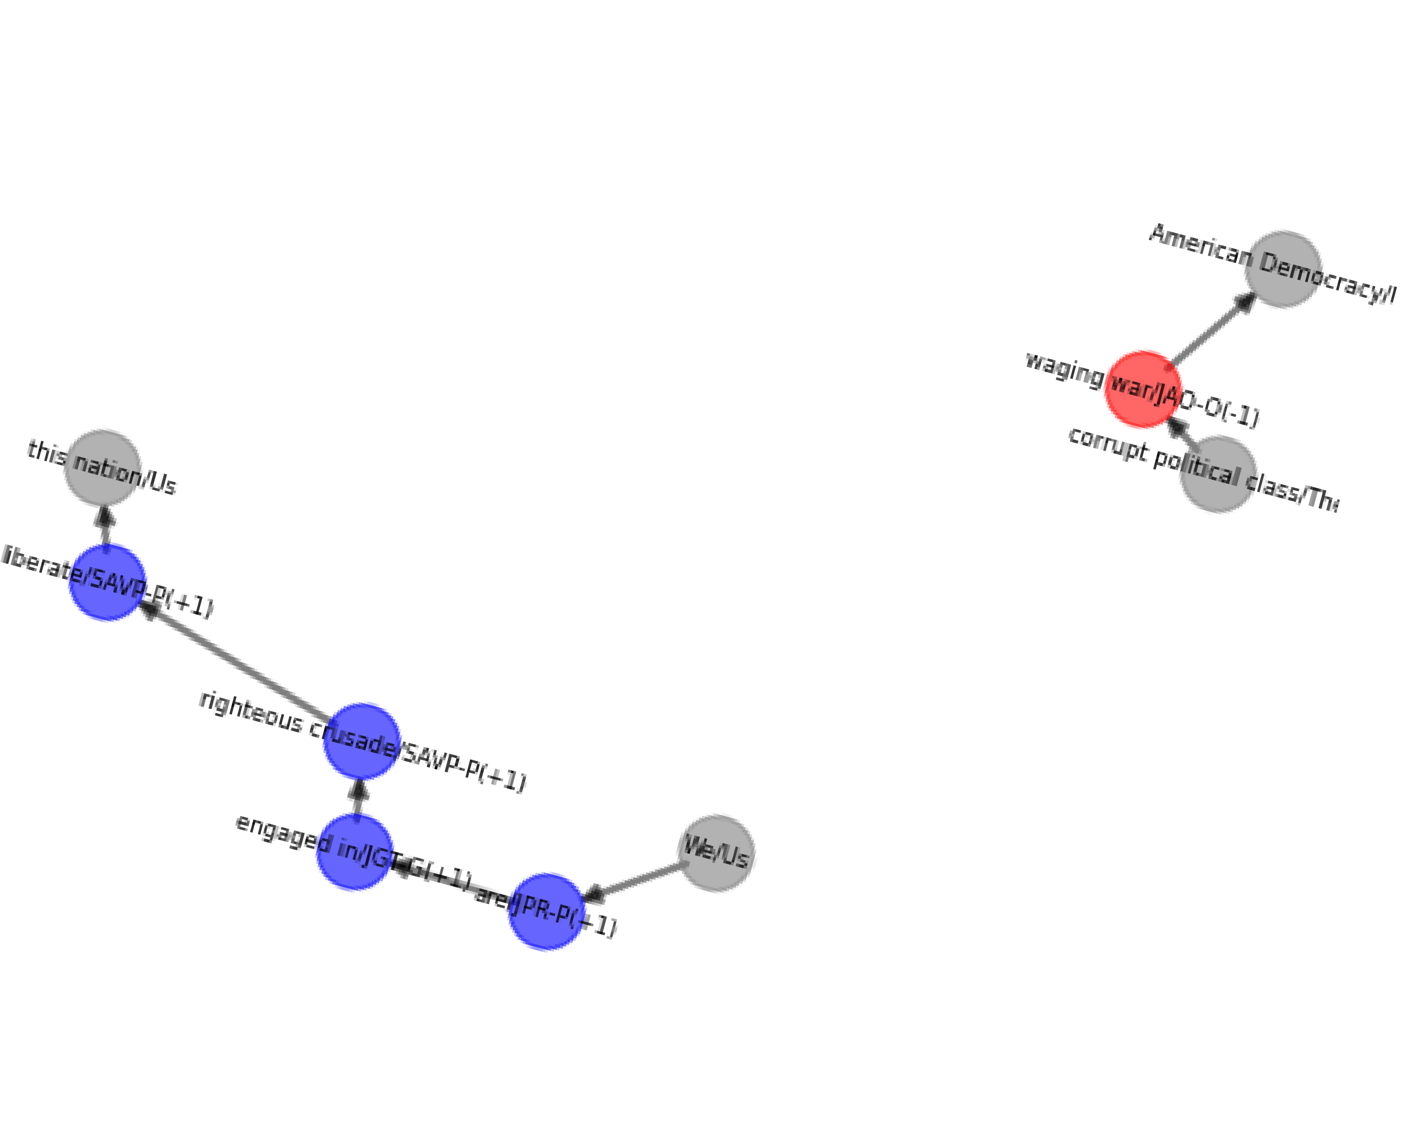
Populist Narrative Structure
Cast THEORETICAL populist narrative types as network motifs
V
V
V
Motif 3
Motif 2
Motif 1
… Many, more

Slide 79
Populist Narrative Structure
Cast THEORETICAL populist narrative types as network motifs
V
V
These come from concept of thin-centered populism, not data
V
Motif 3
Motif 2
Motif 1
… Many, more

Slide 80
Populist Sentence Level Motifs
Victimization Elite Conspiracy Empowerment Resistance
-1
Us
+1
+1
Us
-1
Them
Them
Them
Them
Us
Us
They hurt us
They help themselves
We help you/us
We hurt them

Slide 81
The Computational Steps from Unannotated Texts to Extracting Narrative Structure

Slide 82
Structure Graph Motif
GED: Search for motif match in subgraphs
Final Data
Annotate text
ACTOR: Them TARGET: US
JUDGEMENT ASPECT-Pos
“Corrupt Elites take our money.”
Speaker
Pop Motif 1
Implicit (in metadata)
-1
Us
+1
-1
Us
LLM
Them
Subgraph
Them
Coded as populist sentence
JUDGEMENT (-1)
ASPECT
(+1)
Pop Motif 2
Valence path
(-1) x (+1) = -1
-1
Them
Us

Slide 83
Structure Graph Motif
GED: Search for motif match in subgraphs
Final Data
Annotate text
ACTOR: Them TARGET: US
JUDGEMENT ASPECT-Pos
“Corrupt Elites take our money.”
Speaker
Pop Motif 1
Implicit (in metadata)
-1
Us
+1
-1
Us
LLM
Them
Subgraph
Them
Coded as populist sentence
JUDGEMENT (-1)
ASPECT
(+1)
Pop Motif 2
Valence path
(-1) x (+1) = -1
-1
Them
Us

Slide 84
Structure Graph Motif
GED: Search for motif match in subgraphs
Final Data
Annotate text
ACTOR: Them TARGET: US
JUDGEMENT ASPECT-Pos
“Corrupt Elites take our money.”
Speaker
Pop Motif 1
Implicit (in metadata)
-1
Us
+1
-1
Us
LLM
Them
Subgraph
Them
Coded as populist sentence
JUDGEMENT (-1)
ASPECT
(+1)
Pop Motif 2
Valence path
(-1) x (+1) = -1
-1
Them
Us

Slide 85
Structure Graph Motif
GED: Search for motif match in subgraphs
Final Data
Annotate text
ACTOR: Them TARGET: US
JUDGEMENT ASPECT-Pos
“Corrupt Elites take our money.”
Speaker
Pop Motif 1
Implicit (in metadata)
-1
Us
+1
-1
Us
LLM
Them
Subgraph
Them
?
Coded as populist sentence
JUDGEMENT (-1)
ASPECT
(+1)
Pop Motif 2
Valence path
(-1) x (+1) = -1
-1
Them
Us

Slide 86
Structure Graph Motif
GED: Search for motif match in subgraphs
Final Data
Annotate text
ACTOR: Them TARGET: US
JUDGEMENT ASPECT-Pos
“Corrupt Elites take our money.”
Speaker
Pop Motif 1
Implicit (in metadata)
-1
Us
+1
-1
Us
LLM
Them
Subgraph
Them
Coded as populist sentence
Match
JUDGEMENT (-1)
ASPECT
(+1)
Pop Motif 2
Valence path
(-1) x (+1) = -1
-1
Them
Us

Slide 87
Structure Graph Motif
GED: Search for motif match in subgraphs
Final Data
Annotate text
ACTOR: Them TARGET: US
JUDGEMENT ASPECT-Pos
“Corrupt Elites take our money.”
Speaker
Pop Motif 1
Implicit (in metadata)
-1
Us
+1
-1
Us
LLM
Them
Subgraph
Them
Coded as populist sentence
Match
JUDGEMENT (-1)
ASPECT
(+1)
Pop Motif 2
Valence path
(-1) x (+1) = -1
-1
Them
Us

Slide 88
Structure Graph Motif
GED: Search for motif match in subgraphs
Final Data
Annotate text
ACTOR: Them TARGET: US
JUDGEMENT ASPECT-Pos
“Corrupt Elites take our money.”
Speaker
Pop Motif 1
Implicit (in metadata)
-1
Us
+1
-1
Us
LLM
Them
Subgraph
Them
Coded as populist sentence
Match
JUDGEMENT (-1)
ASPECT
(+1)
Pop Motif 2
Valence path
(-1) x (+1) = -1
-1
Them
Us

Slide 89
“We are engaged in a righteous crusade to liberate this nation from a
corrupt political class that is waging war on American democracy”

Slide 90
“We are engaged in a righteous crusade to liberate this nation from a
corrupt political class that is waging war on American democracy”

Slide 91
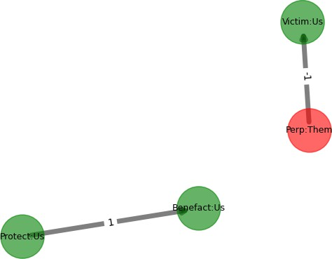
Reduce path/hyper-edge to simple edge and use labels
“We are engaged in a righteous crusade to liberate this nation from a
corrupt political class that is waging war on American democracy”

Slide 92
“We are engaged in a righteous crusade to liberate this nation from a
corrupt political class that is waging war on American democracy”
Check for Matches among populist motifs
Matches Populist Motif
Pop Motif 3
Us
Pop Motif 2
Us
Coded as populist sentence
-1
Them
Us
Coded as populist sentence

Slide 93
Our Approach in Action
Valentina Gonzalez-Rostani, Bree Bang-Jensen, and Michael Colaresi

Slide 94
Strategic Usage of Populism: Trump's 2016 Campaign
Data: 89 Trump rally speeches from 2016 General Election
Replication data Gonzalez-Rostani (2025): Presidential Project & YouTube
Method: AI-based annotation with populist motif detection (GED=0)
Validation: Confirmed by dictionary-based populism measures
New Questions can be answered
Temporal Dynamics
Geographic Focus: Competitive Elections & Target Vulnerable Workers

Slide 95
Strategic Usage of Populism: Trump's 2016 Campaign
Data: 89 Trump rally speeches from 2016 General Election
Replication data Gonzalez-Rostani (2025): Presidential Project & YouTube
Method: AI-based annotation with populist motif detection (GED=0)
Validation: Confirmed by dictionary-based populism measures
New Questions can be answered
Temporal Dynamics
Geographic Focus: Competitive Elections & Target Vulnerable Workers

Slide 96
Strategic Usage of Populism: Trump's 2016 Campaign
Data: 89 Trump rally speeches from 2016 General Election
Replication data Gonzalez-Rostani (2025): Presidential Project & YouTube
Method: AI-based annotation with populist motif detection (GED=0)
Validation: Confirmed by dictionary-based populism measures
New questions can be answered
Temporal Dynamics
Geographic Focus: Competitive Elections & Target Vulnerable Workers

Slide 97
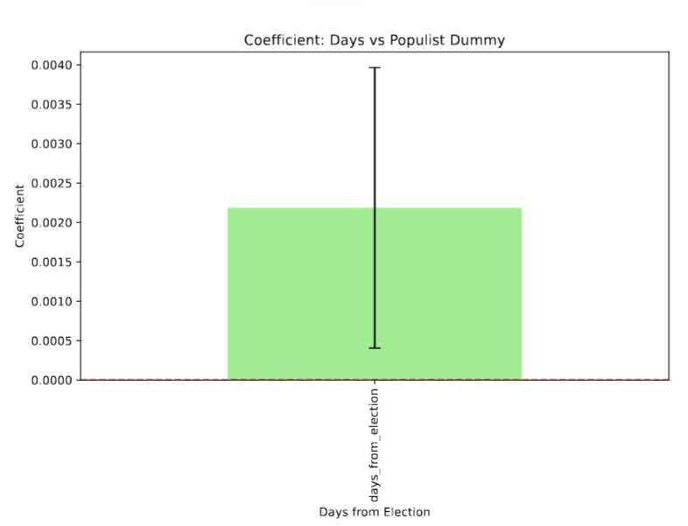
Strategic Usage of Populism: Trump's 2016 Campaign
Which Type?
Temporal Dynamics: Increased populist rhetoric closer to election day

Slide 98
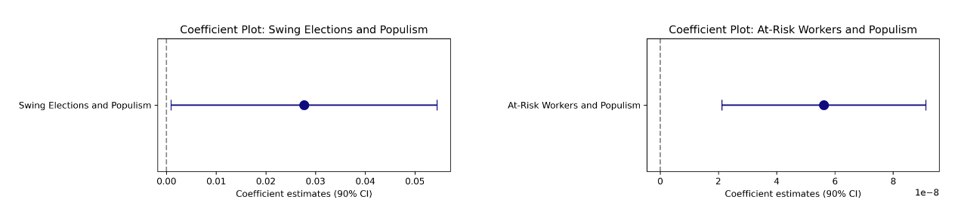
Strategic Usage of Populism: Trump's 2016 Campaign
Which Type?
Economic Context:
Greater populist usage in automation vulnerable regions
Geographic Focus:
Greater populist usage in swing states

Slide 99
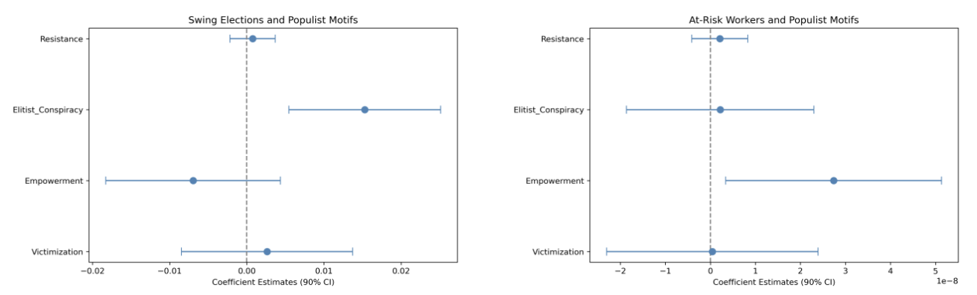
Strategic Usage of Populism: Trump's 2016 Campaign
Which Type?
Geographic Focus:
Greater use of Elite Conspiracy frame in swing states
Economic Context:
Greater use of Empowerment frame in automation vulnerable regions

Slide 100
Final Remarks
Our Fine-Grained approach allows to answers new questions:
Selective use, timing, and context-dependence of populist rhetoric

Slide 101
Much more work to do…
Final Remarks
Our Fine-Grained approach allows to answers new questions:
Selective use, timing, and context-dependence of populist rhetoric
Improve supervised learning and labeling of tokens with attributes
Extend motif extraction across sentences and paragraphs: co-reference resolution
Validate and adapt framework for comparative international research

Slide 102
Much more work to do…
Final Remarks
Our Fine-Grained approach allows to answers new questions:
Selective use, timing, and context-dependence of populist rhetoric
Improve supervised learning and labeling of tokens with attributes
Extend motif extraction across sentences and paragraphs: co-reference resolution
Validate and adapt framework for comparative international research
Thank you!
gonzalezrostani@princeton.edu | gonzalez-rostani.com

Slide 103
Supplementary Slides
Valentina Gonzalez-Rostani, Bree Bang-Jensen, and Michael Colaresi

Slide 104
Supplementary Slides
Existing Measures
Ontology
Scale up- token level model
Examples: 1, 2, 3, 4
Example Motifs with Graph
Complex cases: Nested, Non-Speaker
LLM: Token-level validation and metrics, Synthetic data
GED definition
Identifying groups
Our Approach in action: Share, Paragraph Trump, Paragraph Obama, Populist using non-pop.
Back: Title, Thin-Centered, Aggregation Problem, Contribution, Our Approach, Components, Structure, Motif, Motif Example, Example 1, GED, GED example, Scale up, Steps, Human annotations, LLM, Fine-tuning, Motif visualization, Full example, Application, temporal dynamics, geographic dynamics 1, geographic dynamics 2, Final Remarks

Slide 105
Previous Works

Slide 106
Overview of Measurement Strategies
Expert Surveys:
Chapel Hill Expert Survey (2017)
POPPA Survey (2018)
Global Party Survey (GPS)
Textual Data Analysis:
Dictionary-based methods (Jagers, Hawkins, Casiraghi, etc.)
Limitations of Existing Approaches
Coarse Granularity:
Binary labels for parties or large text segments
Fails to capture nuanced, "thin-centered" definitions (Mudde, 2007)
Ignores rhetorical variation within parties, speeches, and individuals
Cannot identify shifts in rhetoric across contexts or topics
Nuance in Populist Discourse
Current methods miss interactions between populism and other discourses (nationalism, anti-globalism, technoskepticism)
Difficulty distinguishing left vs. right populism

Slide 107
Human Costs and Adaptability Tradeoffs
Manual annotation methods:
High resource costs, extensive training
Difficult to scale
Dictionary-based methods:
Efficient but context-specific
Require extensive adaptation across languages and political contexts
Risk of misinterpretation when decontextualized (Schaffer, 2000)

Slide 108
The Populist-PULSAR Ontology
Foundation: Extends PULSAR framework (Park et al., 2018)
Structure of Annotations:
Labels encode populist narrative components and their connections
Applied to sentence-level tokens, preserving context and positional information
Data Representations:
Graph-based (nodes: Actors, Targets, Judgments; edges: dependencies)
Advantage over Dictionary-based Approaches:
Context-aware labeling
Precise location tracking within text

Slide 109
Fine-tunning Our Models - PyTorch
Label | Attribute | Precision | Recall | F1 | Accuracy
Actor |  |  |  |  | 0.9345
 | Them | 0.46 | 0.46 | 0.46
 | Residual | 0.20 | 0.27 | 0.23
 | Us | 0.67 | 0.72 | 0.70
Target |  |  |  |  | 0.9035
 | Them | 0.27 | 0.33 | 0.30
 | Residual | 0.00 | 0.00 | 0.00
 | Us | 0.33 | 0.30 | 0.31
Judgment |  |  |  |  | 0.8595
 | NEG (-1) | 0.05 | 0.04 | 0.05
 | POS (+1) | 0.15 | 0.18 | 0.16
Aspect |  |  |  |  | 0.6901
 | NEG (-1) | 0.08 | 0.11 | 0.10
 | POS (+1) | 0.13 | 0.16 | 0.14
Token-Level Approach
Separate BERT models for BIO tagging
Identifies precise token spans
Fine-tuned individually per component

Slide 110
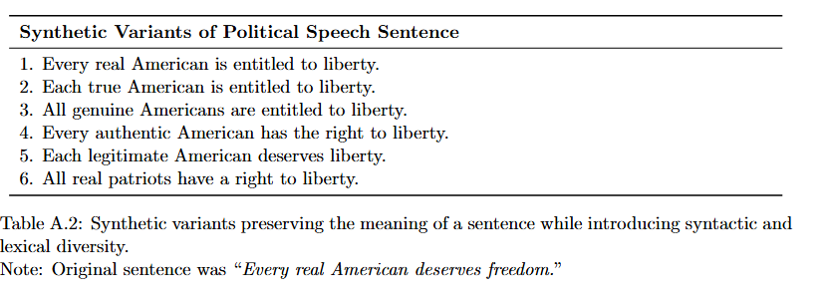
Synthetic Sentences

Slide 111
Definition of GED:
GED measures differences between two narrative structures (graphs), expressed as a numerical distance.
Formally: GED(G_i, G_j) → d_ij, with d_ij as a positive real number.
Distance Calculation Rules:
Maximum single-edit distance is 4 (changing valence from positive to negative or vice versa).
Changing "US" to "THEM" in either the Actor or Target role has a distance of 2 per edit.
Distances from multiple edits are additive (e.g., changing Actor-US to Actor-THEM and Target-THEM to Target-US totals a distance of 4).
The smallest non-zero distance is 1, applicable when changing from specified roles (US or THEM) to residual (unspecified) roles.
Analogy:
Similar to Manhattan distance, calculating distances independently for each dimension.

Slide 112
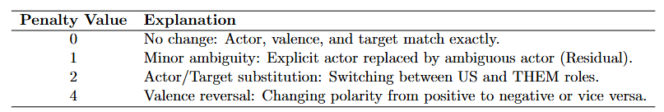
Conceptual Explanation of GED Penalization System

Slide 113
Evaluating LLM Performance Token Annotation
Objective: Measure if iterative improvements in prompts enhanced model accuracy.
Method:
GED-based metric.
Compared LLM-generated annotations to human annotations (our silver standard).
More robust evaluation than token-level accuracy.
Follows recommended practices for tailored benchmarks in prompt engineering research (Schulhoff, 2025).
Acceptance Criteria (GED Scores):
Acceptable if GED = 0 or 1 (minor differences).
Also acceptable if GED = 2 or 3, provided misclassifications involve minor roles only (e.g., labeling "Residual" instead of "US"/"THEM"), without polarity reversals.

Slide 114
LLM Performance
Overall Performance:
76.2% of classifications were acceptable.
Detailed Breakdown:
27.4% Exact matches (GED = 0): Perfect alignment with human annotations.
40.5% Minimal differences (GED = 1): Minor misclassification between known groups and "Residual."
Implications:
Most discrepancies minor, preserving key structural elements.
Highlights effectiveness of refining prompts to improve LLM annotation quality.

Slide 115
Examples 1
“Joe Biden wants to inflict a painful shutdown on our entire country”

Slide 116
Calculate Judgment holder valence on motif
“Joe Biden wants to inflict a painful shutdown on our entire country”
Label text, dependency parse, and calculate valence
Compute role and valence graph
Search for motif match in subgraphs
ACTOR
Us
TARGET
Us
ACTOR
Them
Target Them
Is an “Us" or “Them” mentioned in the ACTOR or TARGET?
ASPECT
Pos
(+1)
ASPECT
Neg (-1)
What aspect is mentioned and is it positive or negative (or neutral)?
What judgment is communicated about whether the aspect is added, subtracted
or neutral?
What is the calculated valence?
X
JUDGE
Pos (-1)
JUDGE
Neg (-1)
JUDGE (-1)
ASPECT
(+1)

Slide 117
JUDGE-
Pos (+1)
X
ASPECT
-Neg (-1)
ACTOR
Them
(-1)
TARGET
Us
“Joe Biden
wants to
inflict
a
painful shutdown
on our entire country”
Label text, dependency parse, and calculate valence
Compute role and valence graph
Search for motif match in subgraphs
Calculate Judgment holder valence on motif
ACTOR
Us
TARGET
Us
ACTOR
Them
Target Them
Is an “Us" or “Them” mentioned in the ACTOR or TARGET?
ASPECT
Pos
(+1)
ASPECT
Neg (-1)
What aspect is mentioned and is it positive or negative (or neutral)?
What judgment is communicated about whether the aspect is added, subtracted
or neutral?
What is the calculated valence?
X
JUDGE
Pos (-1)
JUDGE
Neg (-1)
JUDGE (-1)
ASPECT
(+1)

Slide 118
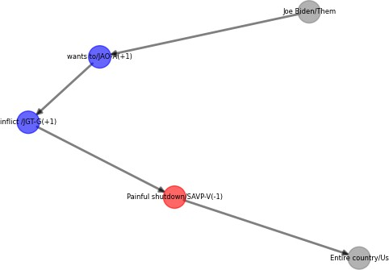
Full Valence Graph With Labels
“Joe Biden wants to inflict a painful shutdown on our entire country”

Slide 119
Follow Valence Path, where path can be thought of as part of a hypergraph
“Joe Biden wants to inflict a painful shutdown on our entire country”

Slide 120
Calculate Judgment holder valence on motif
“Joe Biden wants to inflict a painful shutdown on our entire country”
Label text, dependency parse, and calculate valence
Compute role and valence graph
Search for motif match in subgraphs
What was the role of the perpetrator/protector (“Us” or “Them” or “Neither”) or victim/beneficiary? (Monism aspect of populism)
Was the valence of the action positive (a good thing) or negative (a bad thing)? (Moralism aspect of populism)
-1
Us
Subgraph
Them

Slide 121
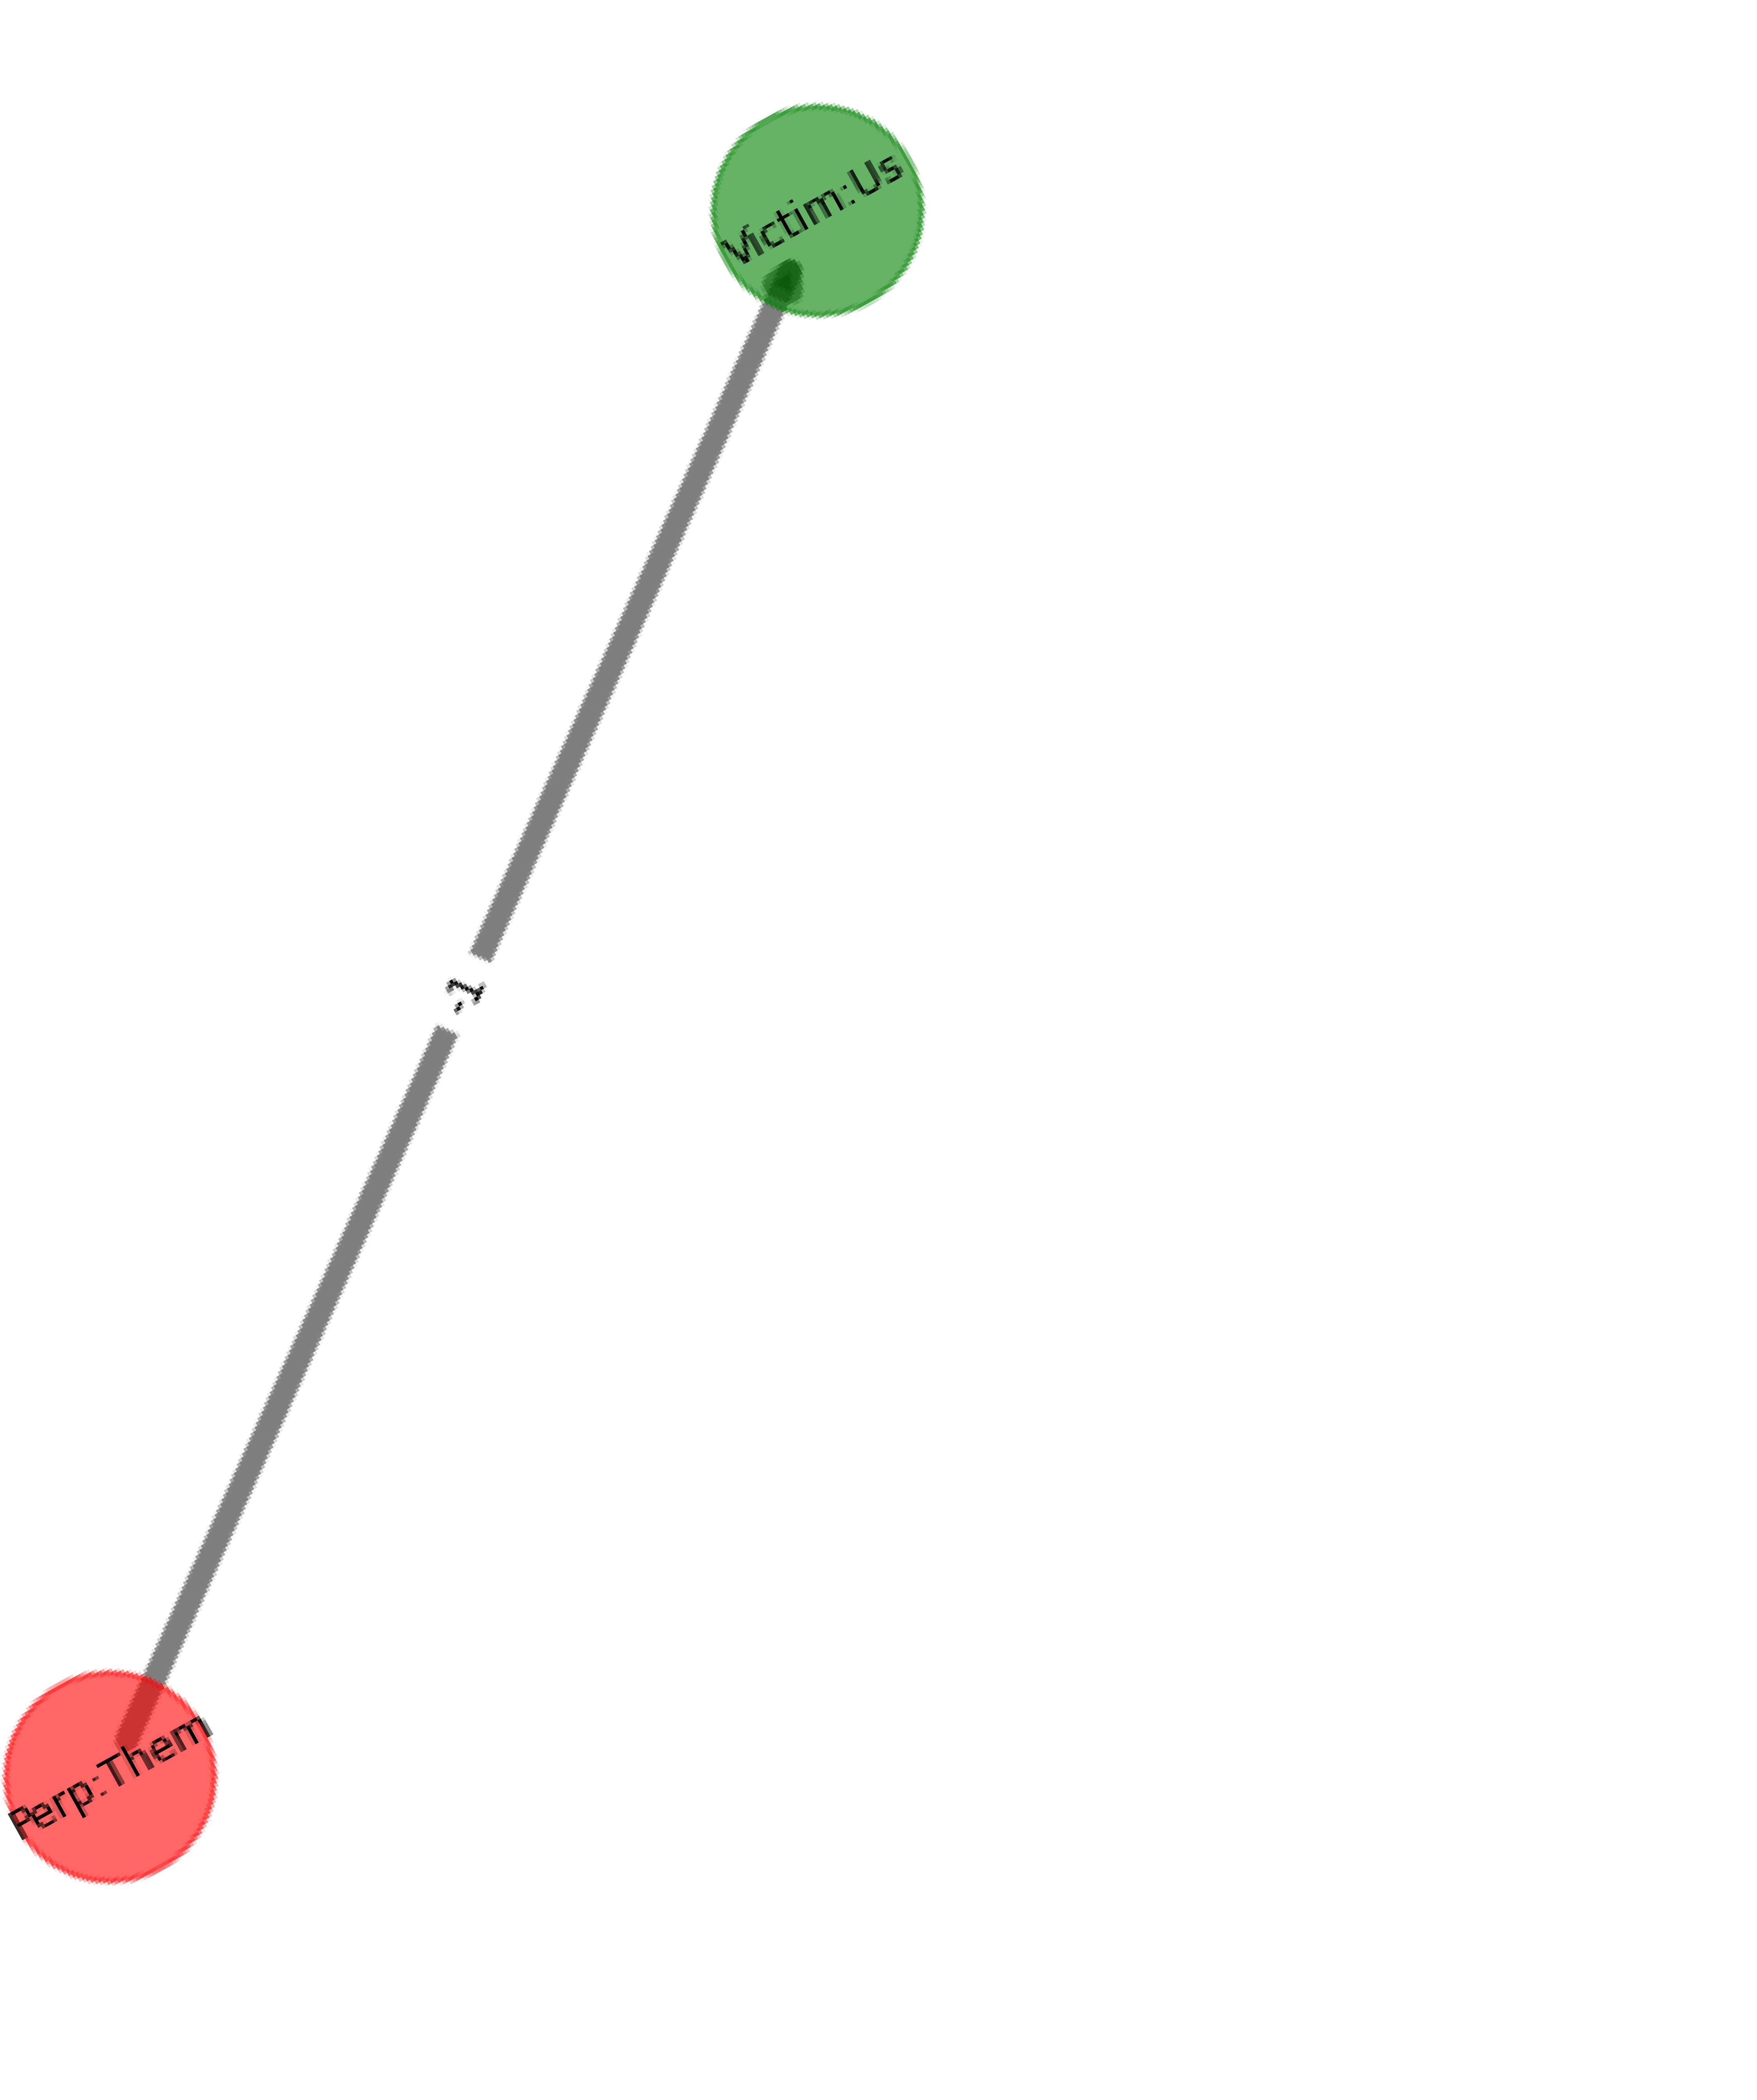
“Joe Biden wants to inflict a painful shutdown on our entire country”
Reduce path/hyper-edge to simple edge and use labels

Slide 122
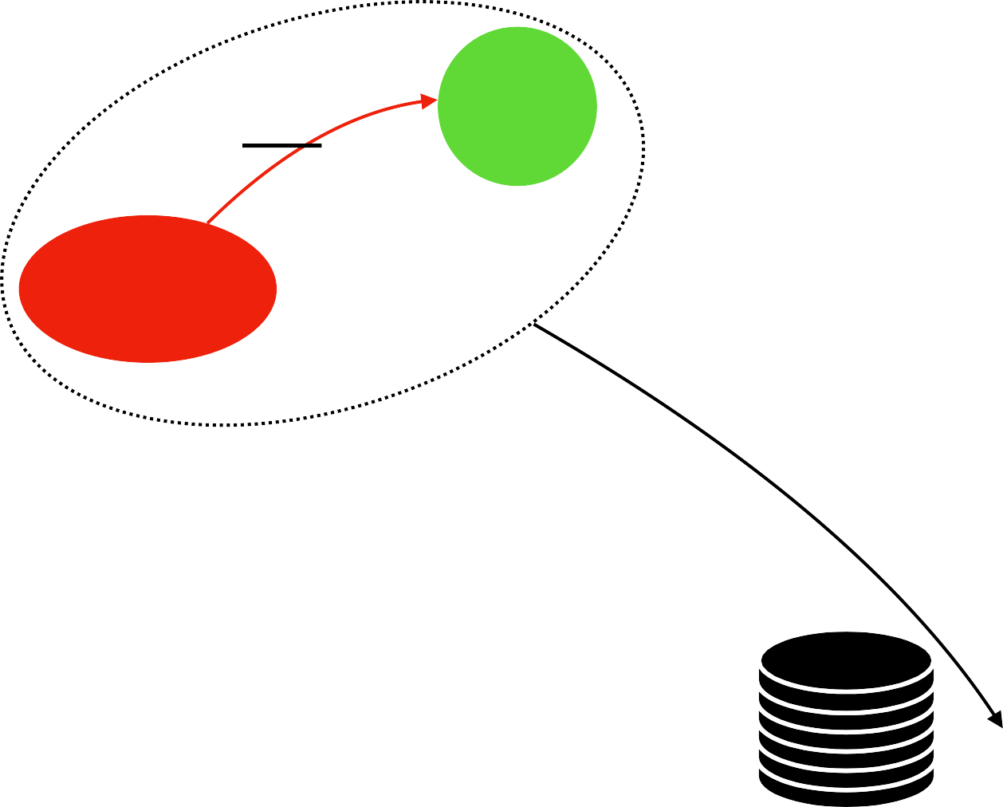
Calculate Judgment holder valence on motif
“Joe Biden wants to inflict a painful shutdown on our entire country”
Label text, dependency parse, and calculate valence
Compute role and valence graph
Search for motif match in subgraphs
-1
Us
Use Graph Edit Distance with curated distances between attributes of nodes and edges, including missing attributes
Subgraph
Them
match?
Does any pre-defined populist motif match any part of the role and valence graph?
Pop Motif 2
-1
Them
Us

Slide 123
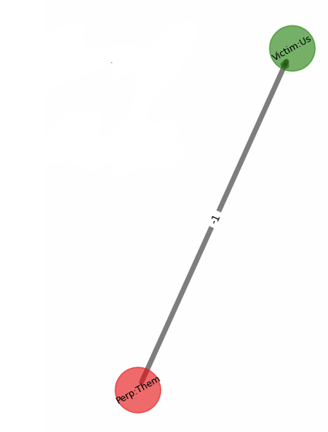
“Joe Biden wants to inflict a painful shutdown on our entire country”
Check for Matches among populist motifs
Matches Populist Motif
Pop Motif 2
-1
Them
Us
Coded as populist sentence

Slide 124
Calculate Judgment holder valence on motif
“Joe Biden wants to inflict a painful shutdown on our entire country”
Label text, dependency parse, and calculate valence
Compute role and valence graph
Search for motif match in subgraphs
Is the speaker expressing a direct judgment in the valence?
Is the speaker taking a position (positive or negative valence) on the valence?
Is the speaker expressing an indirect position, such that they are talking about someone else’s position?
Is the speaker taking a position on an indirect position?
Pop Motif 2
+1
?
Speaker
-1
Them
Us
-1
Judgment Holder

Slide 125
Calculate Judgment holder valence on motif
“Joe Biden wants to inflict a painful shutdown on our entire country”
Label text, dependency parse, and calculate valence
Compute role and valence graph
Search for motif match in subgraphs
Is the speaker expressing a direct judgment in the valence?
Is the speaker taking a position (positive or negative valence) on the valence?
Is the speaker expressing an indirect position, such that they are talking about someone else’s position?
Is the speaker taking a position on an indirect position?
Pop Motif 2
+1
Speaker
-1
Them
Us

Slide 126
Example 2
“We are engaged in a righteous crusade to liberate this nation from a corrupt political class that is waging war on American democracy”

Slide 127
Calculate Judgment holder valence on motif
“We are engaged in a righteous crusade to liberate this nation from a corrupt political class that is waging war on American democracy”
Label text, dependency parse, and calculate valence
Compute role and valence graph
Search for motif match in subgraphs

Slide 128
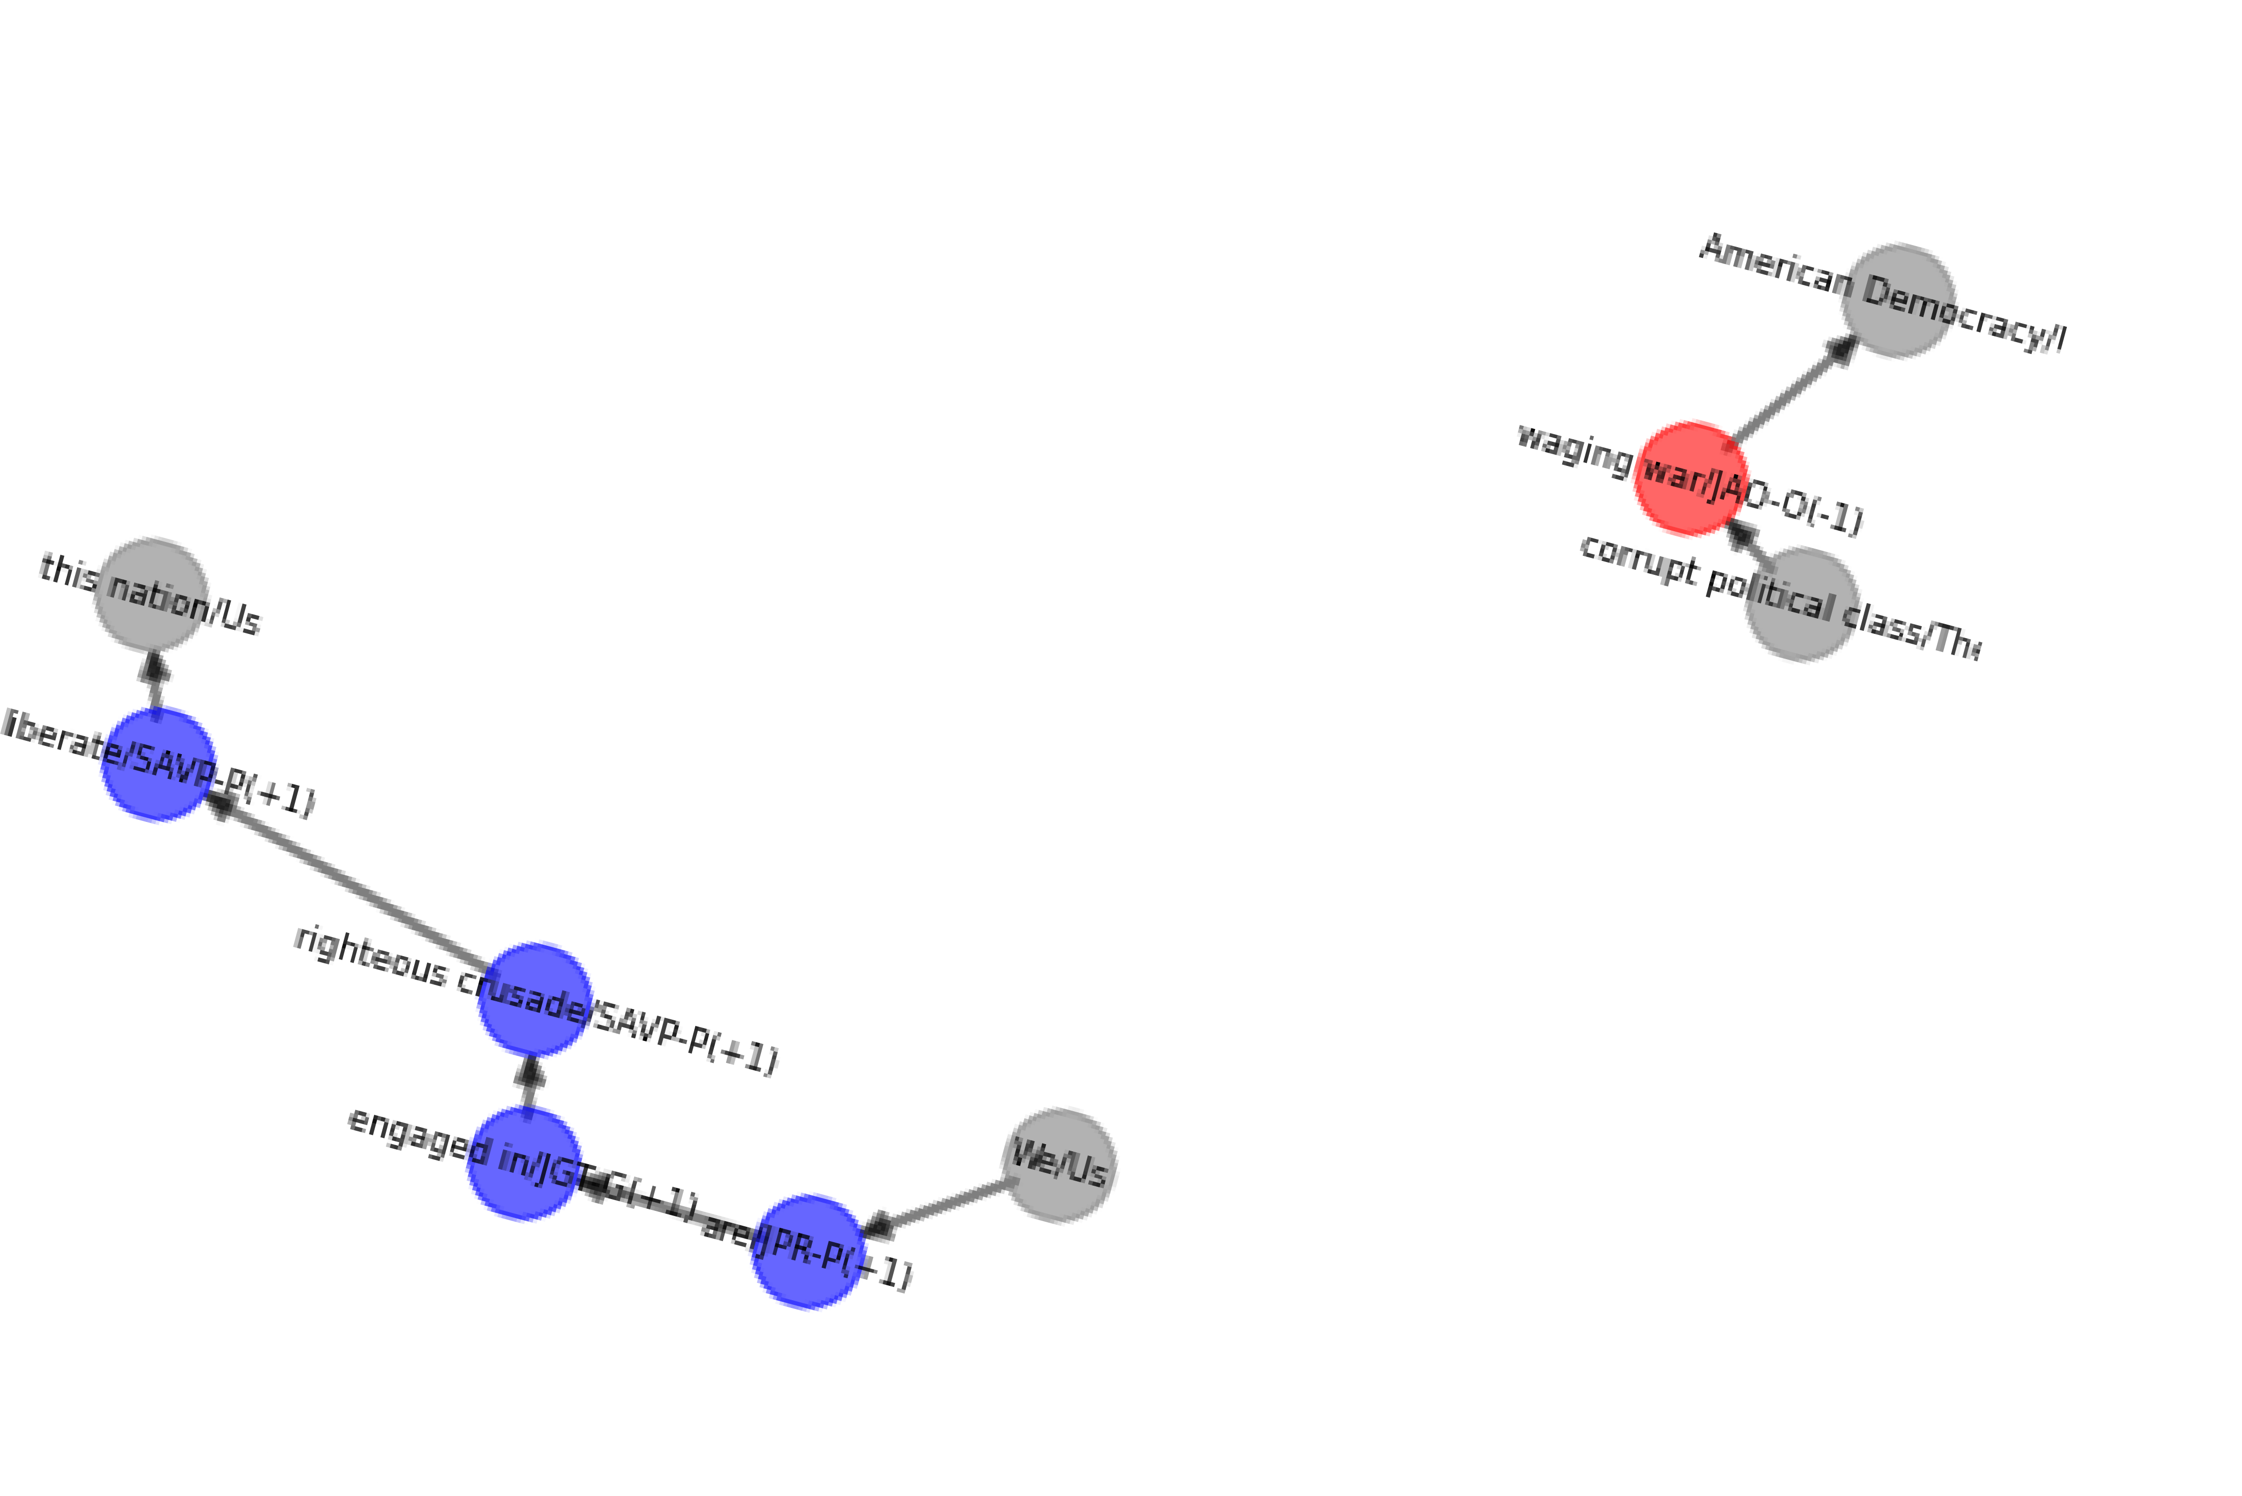
Full Valence Graph With Labels
“We are engaged in a righteous crusade to liberate this nation from a corrupt political class that is waging war on American democracy”

Slide 129
Follow Valence Path, where path can be thought of as part of a hypergraph
“We are engaged in a righteous crusade to liberate this nation from a corrupt political class that is waging war on American democracy”

Slide 130
Motifs with Graphs

Slide 131
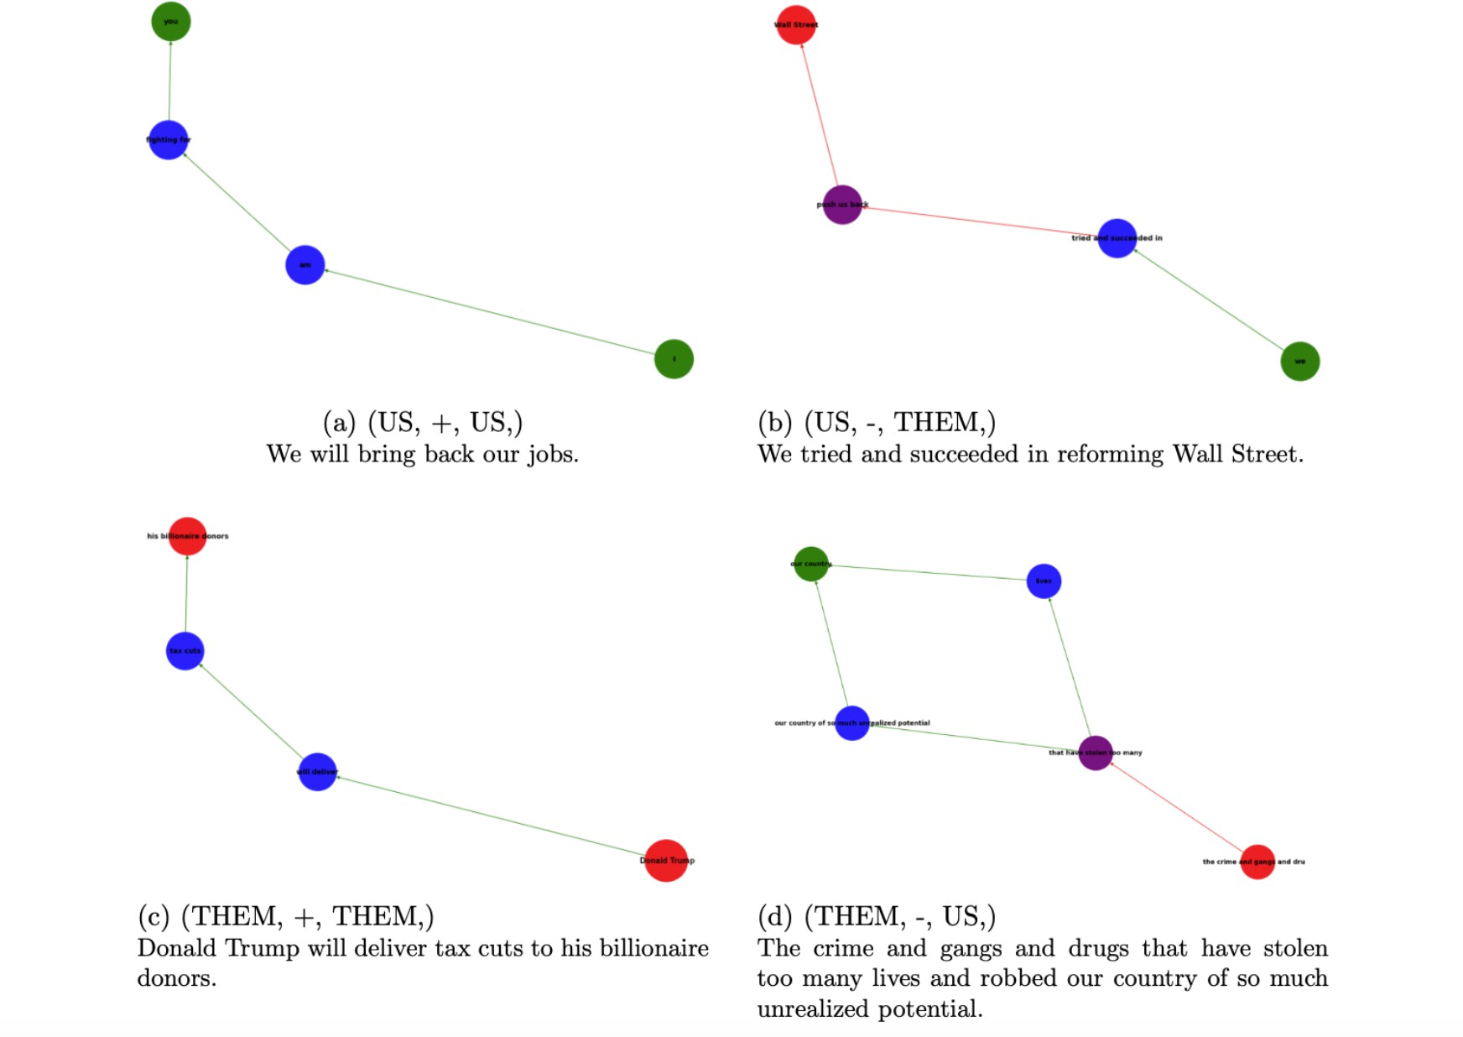
Example Motifs with Text

Slide 132
Example 3 From Labels to Network

Slide 133
Solution: Step 1
Cast text into a network
“A small group in our nation’s capital reaped the rewards of government, while the people have borne the cost”- Donald Trump
while
the people
A small group in our nation’s capital
Us
contrast
Them
Donald Trump
Have borne the cost
reaped the rewards of government
-
+
Victim/
Perpetr-

Slide 134
Solution: Step 1
Cast text into a network
Tokens as nodes, relations as edges
Nodes and edges have labels/attributes
“A small group in our nation’s capital reaped the rewards of government, while the people have borne the cost”- Donald Trump
while
the people
A small group in our nation’s capital
Us
contrast
Them
Donald Trump
Have borne the cost
reaped the rewards of government
-
+
Victim/
Perpetr-

Slide 135
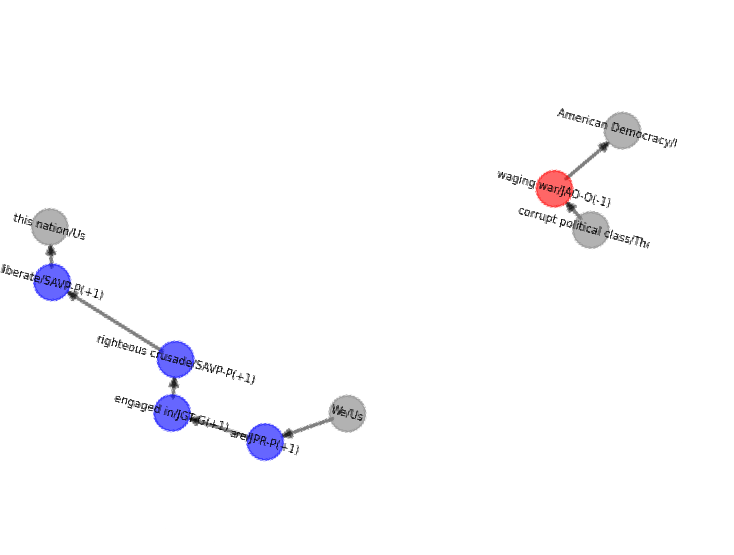
Solution: Step 1
Cast text into a network
Tokens as nodes, relations as edges
Nodes and edges have labels/attributes
“A small group in our nation’s capital reaped the rewards of government, while the people have borne the cost”- Donald Trump
while
the people
A small group in our nation’s capital
Us
contrast
Them
Donald Trump
Have borne the cost
reaped the rewards of government
-
+
Victim/
Perpetr-

Slide 136
Complex Cases: Nested

Slide 137
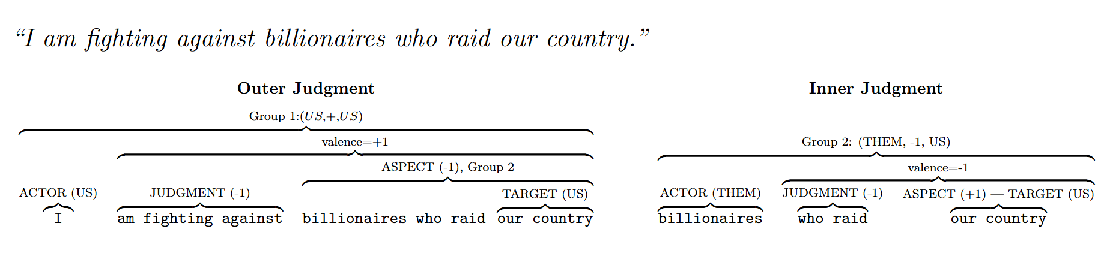
Nested…

Slide 138
Nested…

Slide 139
Nested…

Slide 140
Nested…
Us
Us

Slide 141
Nested…
Us
Us

Slide 142
Nested…
Us
Us
Them
Us

Slide 143
Complex Cases: Not the Speaker

Slide 144
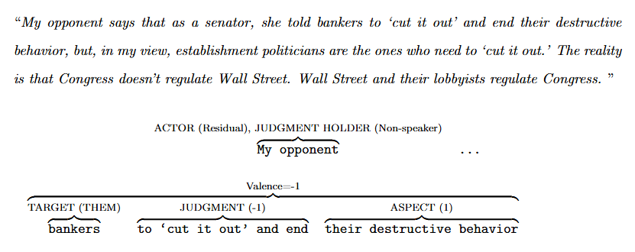

Slide 145
Components

Slide 146
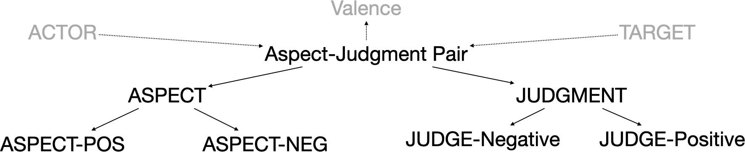
ACTOR
TARGET

Slide 147
Populist Motifs

Slide 148
Populist Sentence Level Motifs
Victimization Elite Conspiracy Empowerment Resistance
-1
Us
+1
+1
Us
-1
Them
Them
Them
Them
Us
Us
They hurt us
They help themselves
We help you/us
We hurt them
+1
-1
-1
+1
Us
Us
Them
Them
…
Them
Us
They support them, and hurt us
They oppose you, we help you

Slide 149
Our Approach in Action
Valentina Gonzalez-Rostani, Bree Bang-Jensen, and Michael Colaresi

Slide 150
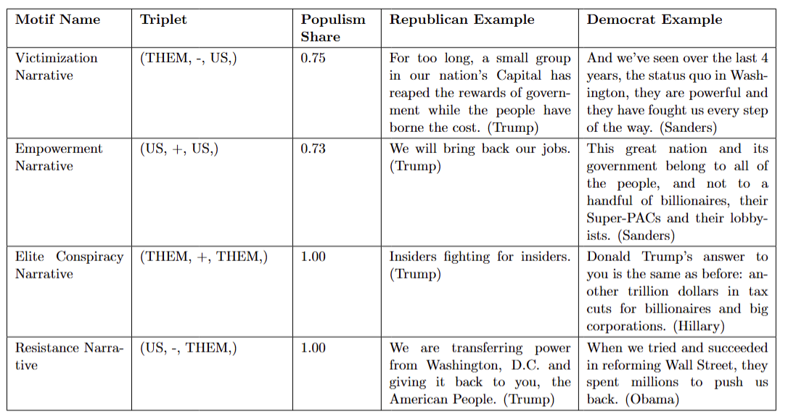
Sentence-level Precision in US Speech Sample

Slide 151
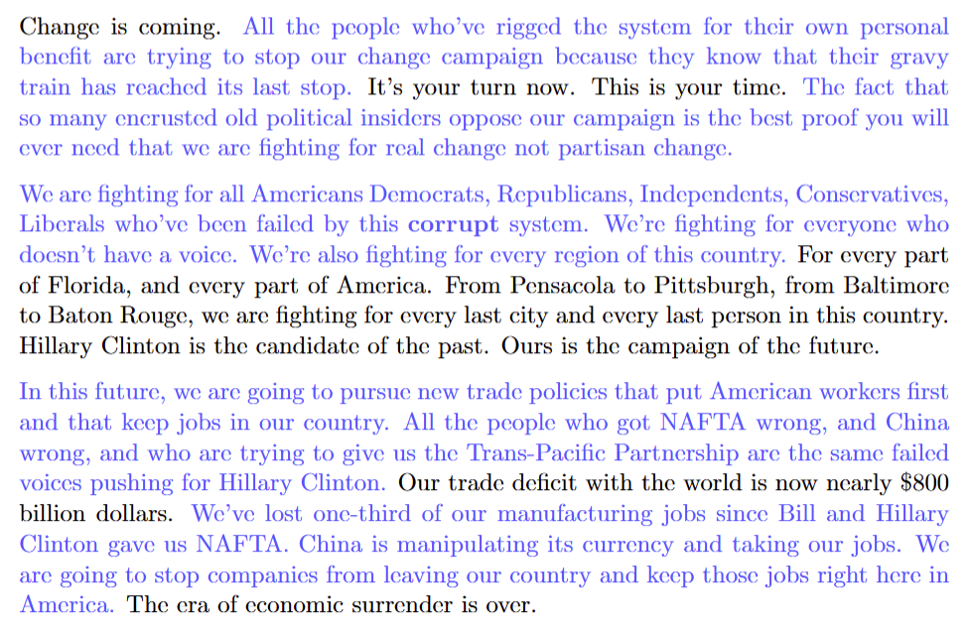
The Aggregation Problem in Computational Measurement of Populist Speech
Donald Trump, September 2016 Pensacola

Slide 152
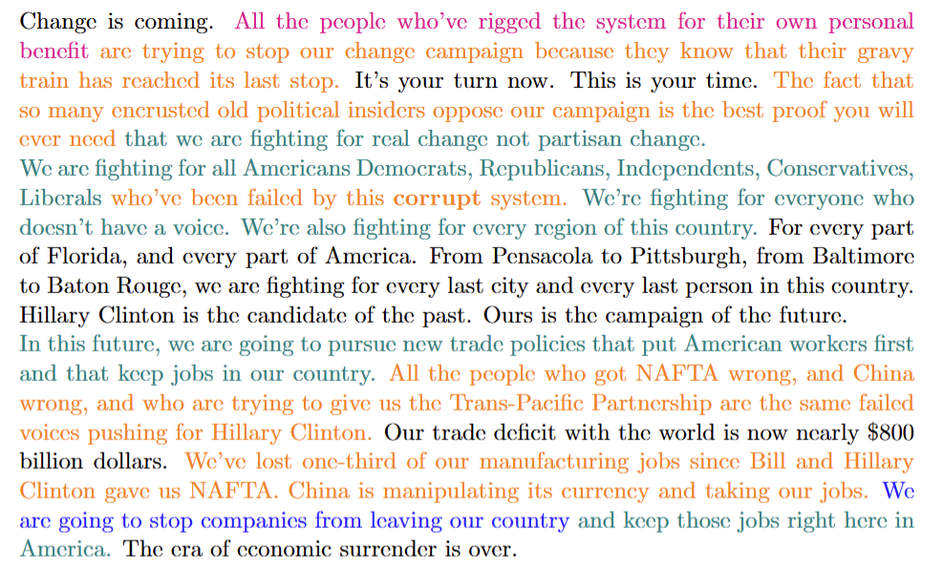
The Aggregation Problem in Computational Measurement of Populist Speech
Donald Trump, September 2016 Pensacola

Slide 153
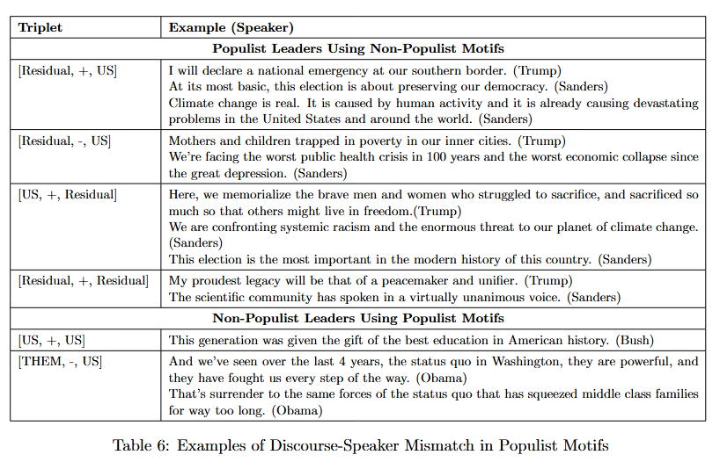

Slide 154
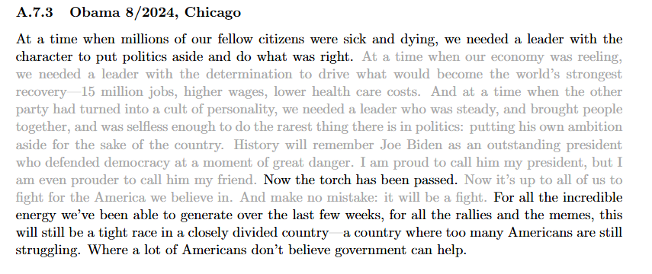

Slide 155
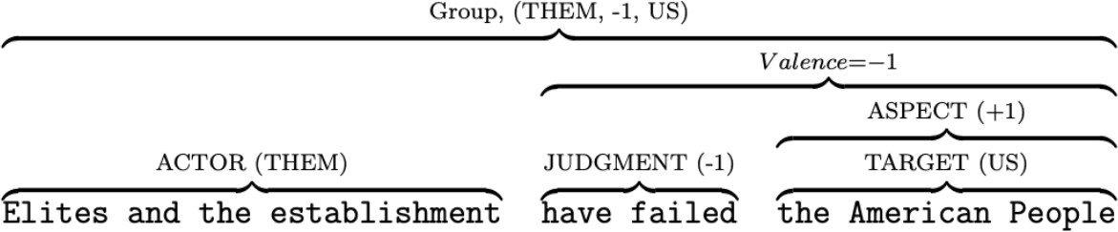
Example 4

Slide 156
Them
Us

Slide 157
Them
Us
(Elites and the establishment, -1, the American People)

Slide 158
Them
Us
(Elites and the establishment, -1, the American People)

Slide 159
Aspect-Based Clustering for Political Text Analysis
→ Train a model to identify aspect-based clusters within political sentences.
Task as Token-Level Clustering:
→ Assign each token to an aspect-defined cluster, reframing the problem as an n-ary relation extraction challenge:
Each ASPECT defines a unique cluster.
Each cluster groups ACTOR, TARGET, and JUDGMENT entities around the ASPECT.
Tokens without entity annotations form a "none" group.

Slide 160
Methodology and Implementation
Why N-ary Relation Extraction?
Relations involve multiple interconnected entities (more than pairs).
Allows capturing multidimensional political narratives.
Approach:
Convert character-indexed annotations → token-level labels.
Preprocess annotated sentences into a format compatible with transformer-based models (e.g., BERT).
Train transformer models for accurate aspect-cluster predictions.
Tools & Dependencies:
Python Libraries:
torch, transformers (BERT)
Data: Annotated sentences in JSON format (processed_annotations.json).

